Slide 1
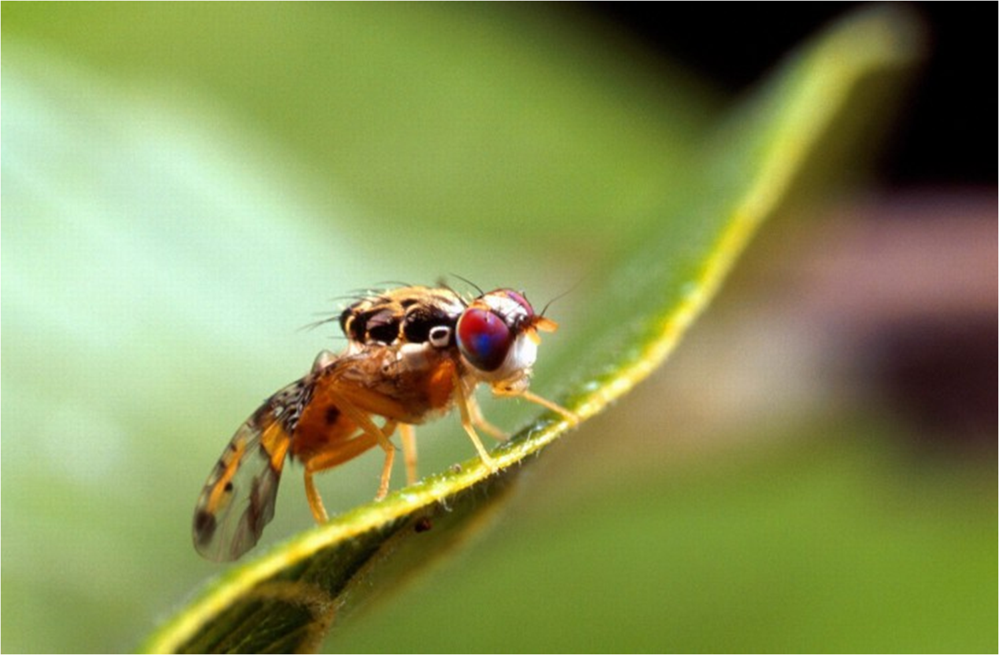

Genome curation guide
Empowering the Medfly community
by Alexie Papanicolaou, Monica Poelchau, Monica Munoz-Torres

Slide 2
Outline and learning outcomes
This document
is aimed for curators of all levels.
sets out the case for community curation in genomics
provides an overview of the curation process
gives the rules that will apply to the curation process
written for biologists confident in genomics but from any discipline

Slide 3
Prerequisites for curating
Lecture: “Genome annotation & community curation”
Experience with genomic data and genome browsers
Basic experience with Web Apollo, e.g. the introductory session by Monica Munoz-Torres
Authorization from Project Leader (Al Handler USDA) and a username/password (Monica Poelchau USDA)

Slide 4
Tasks at hand
While co-ordinating with your community:
Find the genes you’re interested in the Automated Predictions
Use your domain expertise to verify they are correct
fix them if need be
Identify if any of the genes you are interested are not automatically annotated
create a new gene model
Agree on a name for each gene and sign off the gene as “Approved”
Assign any Controlled vocabulary terms and database cross-references that are valid due to experiments you or the community performed
(not automated “similarity inferences”)
Provide feedback to the i5k bioinformatic groups: Terence and Alexie for annotations, Monica Poelchau for browsers/websites, Monica Munoz-Torres for the JBrowse and Web Apollo software.
Suggest topics and figures for the main genome paper to Al Handler
Don’t get too frustrated with computers: tell us how to make it easier for next time

Slide 5
Rules rules rules: how to start
Golden rule: Place any comments and information in the 'mRNA' section of the annotation info editor.
If the gene prediction is 100% accurate:
Add information about your modifications in the Information Editor
If the gene prediction is not accurate:
Only change an existing annotation if you have good evidence that it is wrong.
Perform gene structure modifications using the Web Apollo interface and external evidence
Add information about your modifications in the Information Editor
The gene is correct but you want to create a new isoform.
Elevate the original gene model/isoform to the user-created annotations track. If not, the original isoform will NOT be included in the final gene set.
Clone the gene, edit the isoform to your liking
Name each new isoform with the suffix ‘-RB’, ‘-RC’..
If your gene is not there: Create a new gene prediction.
In first instance try to use evidence tracks (e.g. Augustus or Snap predictions etc) to generate your gene prediction. Otherwise, the current Web Apollo doesn’t let you can’t create a new one so email us to create one for you.
Add information about your modifications in the Information Editor. Use both ‘gene’ as well as the standard ‘mRNA’
You know this gene is not real. Delete a gene prediction.
Elevate the gene prediction to the User-created annotations track.
In the Information Editor Status section, select the "Delete” radio button. Add information that supports your claim in the (mRNA) comments section.

Slide 6
Rules rules rules: Structural annotation
The Information Editor (required)
Status
Click 'Approved' when you have confirmed that the annotation is correct.
Comments
Select one of the canned comments to describe your actions. Use multiple if applicable.
If none of the existing comments describe your gene structure modifications, email Monica P to add a new canned comment to the list.
Add a comment: validated by [your name]
Everyone who signs off on this gene and has manually checked this should do it.
Add any other comments that were needed to describe your comments. Be concise yet informative: these comments will eventually be made public to the world.

Slide 7
Rules rules rules: Structural annotation
The Information Editor (optional)
Name
Full name of the gene plus isoform, in the format (e.g. 'ultraspiracle isoform A'). For multiple isoforms, use sequential letters, i.e. B, C…
Use the community nomenclature for your gene.
Triple check for typos
Symbol
Only if the community has an official symbol, add the gene symbol (e.g. 'USP').
Description
Don’t use, use ‘Comments’ to add any further info

Slide 8
Rules rules rules: Functional annotation
The Information Editor (required)
Comments
Web Apollo currently does not let you provide an evidence code when assigning a GO term. So we must use the Comment section.
Assign one and only one three letter evidence code for each GO ID you assign (see relevant slide)
Use this format: GO:12345=IEA
It’s likely that IEA (Inferred from Electronic Annotation) will be common: use it for anything that is derived because another genome’s protein you got a correct BLAST hit from (e.g. Drosophila) has that GO ID.
Don’t use the Computational Analysis Evidence Codes unless you did do an in-silico experiment or e.g. identified the key residues
As for structural annotation, add any other comments that were needed to describe your comments. Be concise yet informative: these comments will eventually be made public to the world.

Slide 9
Rules rules rules: Functional annotation
The Information Editor (optional)
Gene Ontology IDs
Assign GO IDs if you have wet- or dry- experimental evidence for them.
Dbxrefs
Cross-references to other databases from which you have derived external evidence to support your curation.
E.g. InterPro for protein domains, or UniProt for homology. Include the database name and evidence ID.
PubMed IDs
If there is any published literature in support of your curation (structural or functional assignment)

Slide 10
Evidence codes
Experimental Evidence Codes
EXP: Inferred from Experiment
IDA: Inferred from Direct Assay
IPI: Inferred from Physical Interaction
IMP: Inferred from Mutant Phenotype
IGI: Inferred from Genetic Interaction
IEP: Inferred from Expression Pattern
Computational Analysis Evidence Codes
ISS: Inferred from Sequence or Structural Similarity
ISO: Inferred from Sequence Orthology
ISA: Inferred from Sequence Alignment
ISM: Inferred from Sequence Model
IGC: Inferred from Genomic Context
IBA: Inferred from Biological aspect of Ancestor
IBD: Inferred from Biological aspect of Descendant
IKR: Inferred from Key Residues
IRD: Inferred from Rapid Divergence
RCA: inferred from Reviewed Computational Analysis
Author Statement Evidence Codes
TAS: Traceable Author Statement
NAS: Non-traceable Author Statement
Curator Statement Evidence Codes
IC: Inferred by Curator
ND: No biological Data available
Automatically-assigned Evidence Codes
IEA: Inferred from Electronic Annotation
http://www.geneontology.org/GO.evidence.shtml

Slide 11

Annotating gene structures
“Gene Models”
(automated predictions; assisted by some evidence)
Curation:
Correct co-ordinates for genes of interest
“Evidence”
(cDNA, HMM searches for protein domains, alignments of assemblies, curated genes or other species)
You’re not alone: you have me, Q-ratore * (or just Q; or Super Q if you’re asking for a big favour).
* Any resemblance to any existing master curator is purely co-incidental

Slide 12
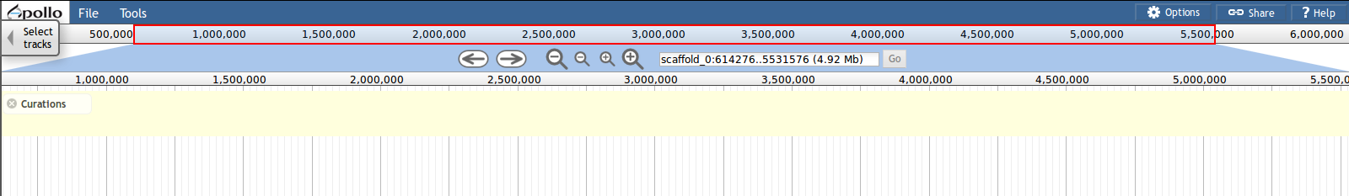
Web Apollo
Grey bar with co-ordinates, tells you where you are. You can also select here in order to zoom to a sub-region
Share/email your view with a stable link. Anyone who clicks on link will see what you see right now (also useful for keeping a record of what you‘ve done)
File: Upload your own evidences
Tools: Use BLAT to search genome with a protein or DNA sequence.
Search box: go to a scaffold or a gene model.
Navigation tools: pan and zoom
Options: change colour of DNA sequence
Yellow box: User annotation area
White area, all other tracks (evidence)
Select which tracks to show
Is lead by the Apollo PI but built using a new browser-based technology (Javascript). Requires no installation.
Is a plugin for JBrowse (Ian Holmes’ lab); the next generation genome browser.
A reference genome is complemented with ‘tracks’ which contain ‘features’ anchored to the genome reference sequence (c.f. relevant lecture)
Plugin offers a “User-created annotations” track.
Editing is real time for everyone who annotates. What you do and see, is immediately seen by everyone else.
A manual is at http://genomearchitect.org/web_apollo_user_guide but this PPT includes all that information (and more)

Slide 13
General Process of Curation
Select a chromosomal region of interest (scaffold)
Select evidence tracks deemed appropriate
Determine whether a feature in an existing evidence track will provide a reasonable gene model to start working with
If yes:
then drag the selected feature to the ‘User-created annotations’ area, creating an initial gene model. Use editing functions to edit the gene model, if necessary
If not:
“We have a problem, Berkeley”. Web Apollo does not offer a facility to create a new one. Contact Monica Poelchau and she will make one for you
Check your edited gene model for consistency with existing homologs
When annotating gene models using Web Apollo, you are looking at a ‘frozen’ version of the genome assembly and you will not be able to modify the assembly itself.

Slide 14
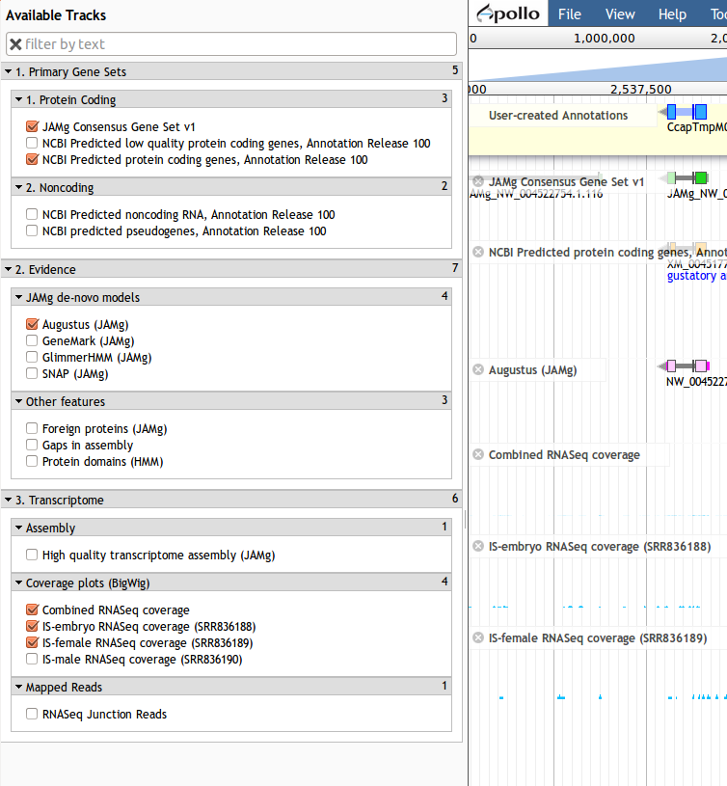
User navigation
Click select tracks on top left to select which tracks to show.
Select the tracks you need for your particular session (you can keep adding and deleting during a session)
The 'User-created annotations' area (a yellow box in the browser) is the area you work in.

Slide 15
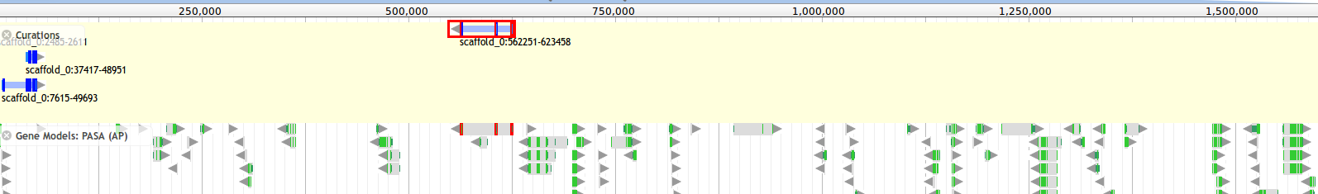
User navigation
The light yellow stripe on top is the 'User-created annotations' area. Every other track is referred to here as an ‘Evidence track’ (even though at least one is the gene prediction tracks)
Evidence track: Click on an exon to select it. Double click on an exon or single click on an intron to select the entire gene.
You can mouse select & drag anything from an evidence track into the curation one. This is editable and considered the curated version of the gene.
You can chose to drag up multiples of the gene you want to curate so you can compare in the 'User-created annotations' track and chose the best one. Always delete any excess ones once you finish the curation.
If you select an exon or gene, then every track is automatically searched for exons with exactly the same co-ordinates as what you selected. These are highlighted red (see above: I selected the gene in Curations area and it highlights the gene in the evidence track).

Slide 16
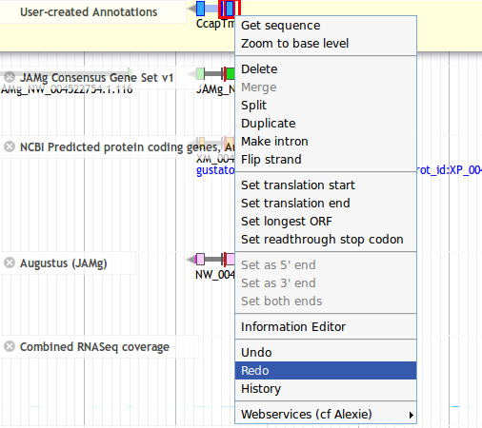
User navigation
With a right-click/apple-click on the gene model, a menu appears with different options.
All edits can be reversed with the ‘Undo’ option. A ‘Redo’ option is also available. All changes are immediately saved and available to all users in real time.
History: See information to see who created this gene.
Get sequence to get the CDS, genomic (incl. introns), or protein sequence.

Slide 17
User navigation
You can select an exon and select delete. You can create an intron, flip the direction, change the start or split the gene.
If you select two gene models, you can join them (‘Merge’)
You can select ‘Duplicate’ if you want to have two versions
At each intron/exon boundary you can click and drag the boundary to change the exon. A (!) will appear if the boundary is a non-canonical intron/exon boundary.

Slide 18
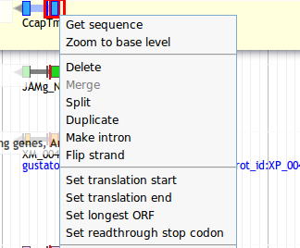
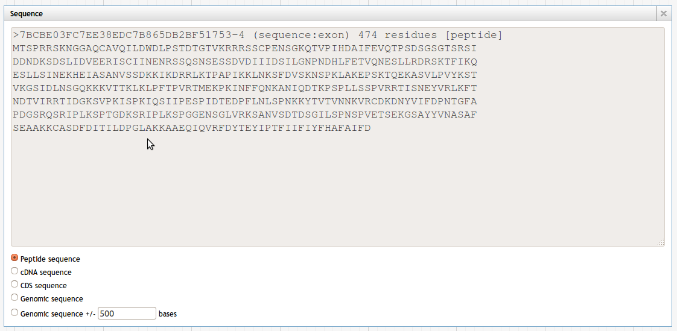
User navigation
You can verify if the sequence is correct by clicking “Get sequence”. If you have selected an exon, then only the exon sequence will appear (see figure). So if you want the whole protein, make sure you have selected the whole gene.

Slide 19
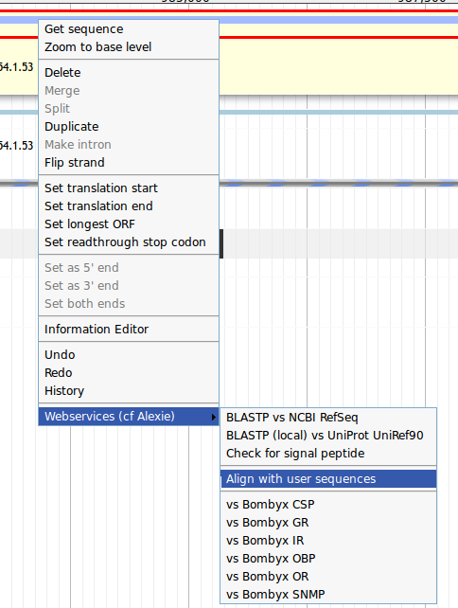
User navigation
We have added a facility that automatically aligns the sequence you selected against our protein families or against a user supplied sequence.
It does this by either
using a profile alignment (the protein families are pre-aligned).
A de-novo global alignment using the unaligned sequences you provided.
If you have pre-aligned sequences you’d like to add, please email Alexie with a FASTA alignment

Slide 20
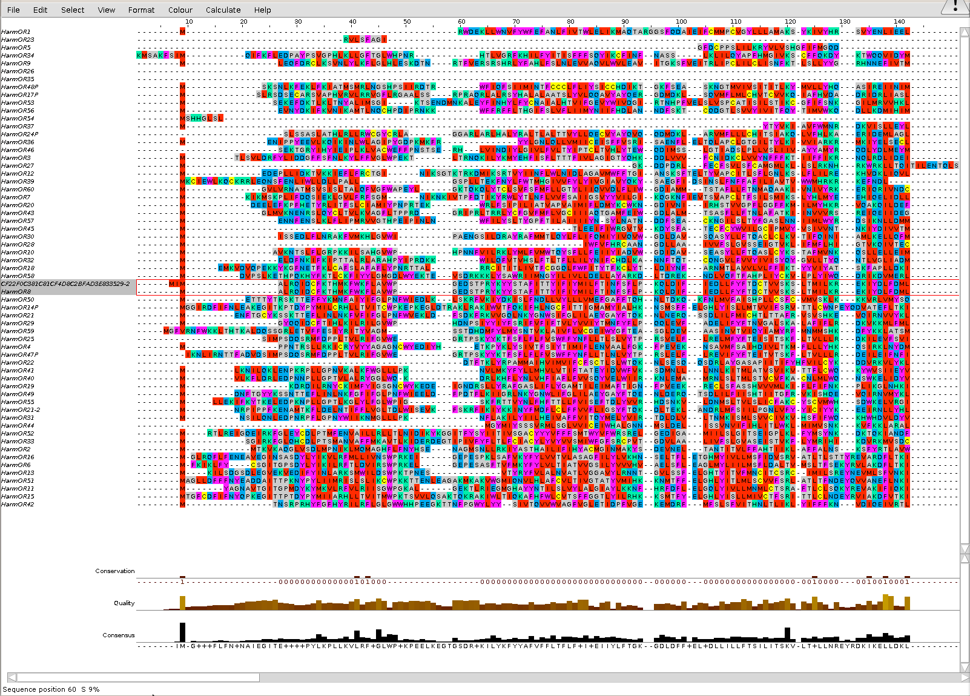
User navigation
You can then view the results in CLUSTALW or FASTA format. Also the JalView plugin is available if you have enabled JAVA on your browser.
Jalview is quite powerful. For example, to sort the alignment JalView data use
Calculate → calculate tree → chose tree
Calculate → sort → by tree order

Slide 21
Jalview video
Select a file format appropriate for you from here: http://insectacentral.org/rd/57bd4b3da5edd8e98dd725b3a7339eab
.avi - big file; should work everywhere
.mp4 - small file may not work on some systems
Tip: can use the videolan to not worry again about video formats (made by french academics):
http://www.videolan.org/vlc/download-windows.html
http://www.videolan.org/vlc/download-macosx.html

Slide 22
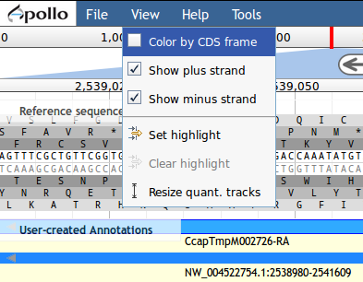
User navigation
If you zoom far enough, you can view the reference sequence nucleotides
With the sequence viewable, you will see the genomic DNA sequence in both directions and the protein translations in all six frames.
Use the View button to display only forward strand or colour by CDS frame

Slide 23
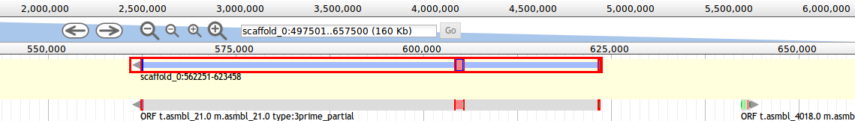
User navigation
You can zoom in/out with keyboard: shift + arrow keys up/down
You can pan left and right with: clicking on the navigation arrows or pressing ‘left’/‘right’ arrows on keyboard. You can press down shift and use the keyboard arrows to make it go faster.
That is, however, very confusing when moving between exons. You can now select a gene on ‘User-created annotations’ track and press [ or ] to jump to the next exon
For example, this gene has a > 25kb intron: lots of panning! So I zoom OUT, then PAN and then select the exon and ‘zoom to base level’ again (or you can zoom in manually).

Slide 24
Examples
(from Web Apollo demo)

Slide 25
Simple Cases
In our definition of “simple case”, the predicted gene model is correct or nearly correct, and this model is supported by evidence that completely or mostly agrees with the prediction. Evidence that extends beyond the predicted model is assumed to be non-coding sequence. The following sections describe simple modifications.

Slide 26
Adding exons
You may select and drag the putative new exon from a track, and add it directly to an annotated transcript in the 'User-created annotations' area.
Click the exon and, holding your finger on the mouse button, drag the cursor until it touches the receiving transcript.
The receiving transcript will be highlighted in dark green when it is okay to release the mouse button. Once you release the mouse button, the additional exon becomes attached to the receiving transcript.
If the receiving transcript is on the opposite strand of the strand on from which you selected the new exon, a dialog box will ask you to confirm.

Slide 27
Adding exons
Each time you add an exon region, whether by extension or adding an exon, Web Apollo recalculates the longest ORF, identifying Start and Stop signals, allowing you to determine whether a stop codon has been incorporated after each editing step.
Web Apollo demands that an exon already exists as an evidence in one of the tracks. You could provide a text file in GFF format and select File → Open. GFF is a simple text file delimited by TABs, one line for each genomic ‘feature’: column 1 is the name of the scaffold; then some text (irrelevant), then ‘exon’, then start, stop, strand as + or -, a dot, another dot, and Name=some name
Example:
scaffold_88 Qratore exon 21 2111 + . . Name=bob
scaffold_88 Qratore exon 2201 5111 + . . Name=rad

Slide 28
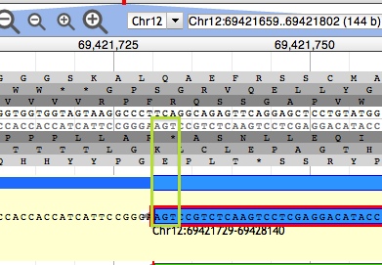
Adding UTRs
Gene predictions may or may not include UTRs. If transcript alignment data are available and extend beyond your original annotation, you may extend or add UTRs.
First, position the cursor at the beginning of the exon that needs to be extended and right click to show the options on the menu and choose to ‘Zoom to base level’.
Place the cursor over the edge of the exon (5’ or 3’ end exon as needed) until it becomes a black arrow then click and drag the edge of the exon to the new coordinate position that includes the UTR.
View zoomed to base level. The DNA track and annotation track are visible. The DNA track includes the sense strand (top) and anti-sense strand (bottom). The six reading frames flank the DNA track, with the three forward frames above and the three reverse frames below. The “user-created annotations” track shows the terminal end of an annotation. The green rectangle highlights the location of the nucleotide residues in the ‘Stop’ signal.
To add a new spliced UTR to an existing annotation follow the procedure for adding an exon.

Slide 29
Exon structure integrity
Zoom in sufficiently to clearly resolve each exon as a distinct rectangle.
When two exons from different tracks share the same start and/or end coordinates, users will see a red bar appear at the edge of the exon.
Use this ‘edge-matching’ function by either selecting the whole annotation or one exon at a time. Scrolling along the length of the annotation, exon boundaries may be verified against available cDNA data.
Also note if there are cDNA that lack one or more of the annotated exons or include additional exons.
To change an exon boundary that needs to be corrected to match data in the evidence tracks zoom to the base pair level, click on the exon to select it and place the cursor over the edge of the exon. When the cursor changes to an arrow, drag the edge of the exon to the desired new coordinates.
In some cases all the data may disagree with the annotation, in other cases some data support the annotation and some of the data support one or more alternative transcripts. Try to annotate as many alternatives transcripts as are well supported by the data.

Slide 30
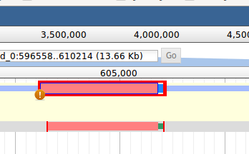
Splice sites
If a non-canonical splice site is present, zoom to base level to review it. These do not necessarily need to be corrected, but should be flagged with the appropriate comment.
Some gene prediction algorithm do not recognize GC splice sites and so the intron/exon junction may be incorrect. For example, a gene prediction algorithm that does not recognize GC splice donors may have ignored a true GC donor and selected another non-canonical splice site that is less frequently observed in nature.
Therefore, if upon inspection you find a non-canonical splice site that is rarely observed in nature, you may wish to search the region for a more frequent in-frame non-canonical splice site, such as a GC donor. If there is an in-frame site close that is more likely to be the correct splice donor, you may make this adjustment while zoomed at base level.
Curated model
Exon/intron junction possible error
Original model
Non-canonical splices (i.e. not 5’-GT/AG-3’) will be indicated by an orange circle with a white exclamation point inside, placed over the edge of the offending exon.
Most insects, including Helicoverpa, have a valid non-canonical site GC-AG. Other non-canonical splice sites are unverified. Web Apollo flags GC splice donors as non-canonical
Use the RNA-Seq data to make a decision.

Slide 31
‘Start’ and ‘Stop’ sites
By default, Web Apollo will calculate the longest possible open reading frame (ORF) that includes canonical Start and Stop signals within the predicted exons.
If it appears that Web Apollo did not calculate the correct Start signal, you may modify it. To set the Start codon manually, position the cursor over the first nucleotide of the candidate Start codon and select the ‘Set translation start’ feature from the right/apple-click, menu. Depending on evidence from a protein database search or additional evidence tracks, you may wish to select an in-frame start codon further up or downstream. An upstream start codon may be present outside the predicted gene model, within a region supported by another evidence track.
Note that the Start codon may also be located in a non-predicted exon further upstream. If you cannot identify that exon, add the appropriate comment (using the transcript comment section in the ‘Comments’ option).

Slide 32
‘Start’ and ‘Stop’ sites
In very rare cases, the actual Start codon may be non-canonical (non-ATG). Add the appropriate comment (using the transcript comment section in the ‘Comments’ option).
In some cases, a stop codon may not be automatically be identified. Check to see if there are data supporting 3’ extension of the terminal exon or additional 3’ exons with valid splice sites.
To check for accuracy of start and stop signals, check the evidence tracks or use the JalView Alignment viewer

Slide 33
Complex Cases: Merge two gene predictions on the same scaffold
Evidence may support the merge of two different gene models. Identify two gene models from the ‘Evidence Pane’ that you would like to merge. A protein alignment may not be a useful starting point because it may have incorrect splice sites and may lack non-conserved regions.
Drag and drop each selected gene model to the 'User-created annotations' area.
You may select the supporting evidence tracks and drag them over the candidate models to corroborate the overlap, and can also zoom in to carefully review edge matching and coverage across models.
Once you are sure you would like to continue with the merge, shift click on an intron from each gene model to highlight both.
Then right click and select merge from the drop down menu.
You should obtain the resulting translation, and check it by searching a protein database, such as UniProt. Be sure to record the IDs of both starting gene models in the ‘DBXref’ boxes and add a comments to record that this annotation is the result of a merge.

Slide 34
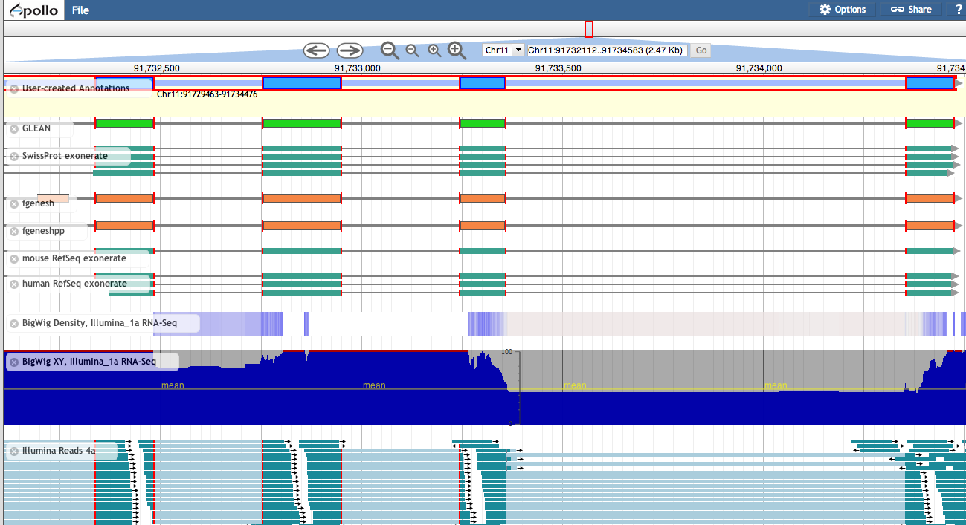
Multiple tracks
Red lines around exons:
When a feature is selected, the exon edges are marked with a red box. All other features that share the same exon boundaries are marked with a red line on the matching edge. This feature allows annotators to confirm that evidence is in agreement without examining each exon at the base level.

Slide 35
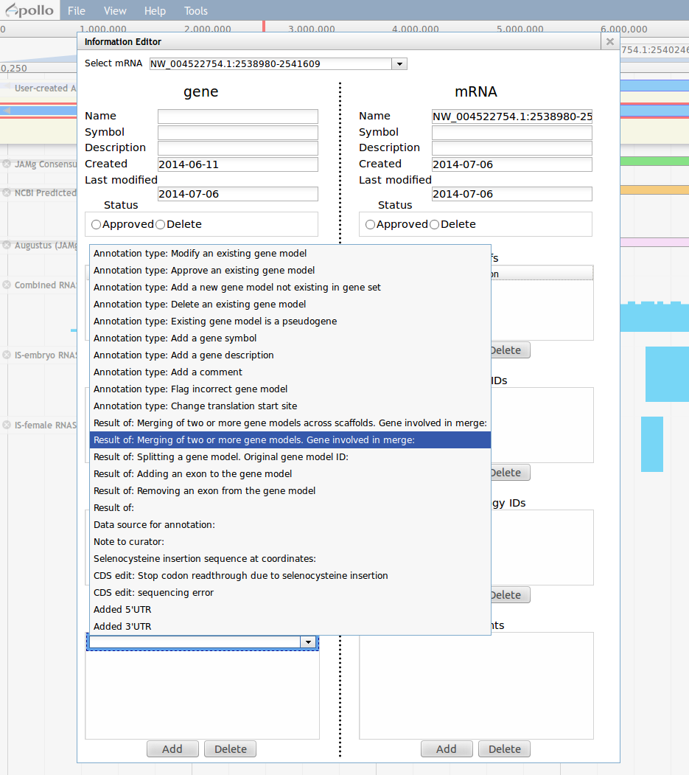
Complex Cases: Merge two gene predictions on different scaffolds
It is not possible to merge two annotations across scaffolds, however annotators should document the fact that the data support a merge in the ‘Comments’ section for both components. For standardization purposes, please use the following comment from the ‘canned’ comments:
"RESULT OF: merging two or more gene models. Gene models involved in merge:"

Slide 36
Complex Cases: Split a gene prediction
One or more splits may be recommended when different segments of the predicted protein align to two or more different families of protein homologs, and the predicted protein does not align to any known protein over its entire length. Transcript data may support a split (in this case, verify that it is not a case of alternative transcripts).
Creating and annotating a split:
To create a split, select the flanking exons using the right/apple-click menu option ‘Split’
Annotate each resulting fragment independently. You should obtain the resulting translation, and check it by searching a protein database, such as UniProt. Be sure to record the original ID for both annotations in the ‘Comments’ section.

Slide 37
Complex Cases: Frameshifts, single-base errors, and selenocysteines
Web Apollo allows annotators to make single base modifications or frameshifts that are reflected in the sequence and structure of any transcripts overlapping the modification. Note that these manipulations do NOT change the underlying genomic sequence.
If you determine that you need to make one of these changes, zoom in to the nucleotide level and right click over a single nucleotide on the genomic sequence to access a menu that provides options for creating insertions, deletions or substitutions.
The ‘Create Genomic Insertion’ feature will require you to enter the necessary string of nucleotide residues that will be inserted to the right of the cursor’s current location. The ‘Create Genomic Deletion’ option will require you to enter the length of the deletion, starting with the nucleotide where the cursor is positioned. The ‘Create Genomic Substitution’ feature asks for the string of nucleotide residues that will replace the ones on the DNA track.
37

Slide 38
Complex Cases: Frameshifts, single-base errors, and selenocysteines
Once you have entered the modifications, Web Apollo will recalculate the corrected transcript and protein sequences, which will appear when you use the right-click menu ‘Get Sequence’ option. Since the underlying genomic sequence is reflected in all annotations that include the modified region you should alert the curators of your organisms database using the ‘Comments’ section to report the CDS edits.
In special cases such as selenocysteine containing proteins (read-throughs), right-click over the offending/premature ‘Stop’ signal and choose the ‘Set readthrough stop codon’ option from the menu.
38

Slide 39
Completing the annotation
Follow the checklist on the the beginning of this slideshow. Make sure you are happy with the annotation.
If you have reason to believe this gene/protein is the same as a gene/protein in a public database (including your own), add the DBXREF (database crossreference).
Remember: Web Apollo curation is a community effort so use comments to communicate the reasons for your annotation (your comments will be visible to everyone).

Slide 40
Checklist
Can you add UTRs if not already there (via RNA-Seq)?
Check exon structures
Check splice sites: most splice sites display this residues …]5’-GT/AG-3’[…
If the splice site is GC/AG, then make sure you comment that you are fine with this.
Check ‘Start’ and ‘Stop’ sites
Check the predicted protein product(s)
Align it against the relevant genes/gene family.
BLASTP against NCBI’s RefSeq or NR

Slide 41
Checklist
If the protein product still does not look correct then check if:
Are there gaps in the genome (genome gap track)?
Merge of 2 gene predictions on the same scaffold
Merge of 2 gene predictions from different scaffolds (comment this too)
Split a gene prediction
Frameshifts
error in the genome assembly?
Selenocysteine, single-base errors, and other inconvenient phenomena

Slide 42
Checklist
Finalize annotation
Adding important project information in the form of canned and/or customized comments
IDs from GenBank (via DBXRef), gene symbol(s), common name(s), synonyms, top BLAST hits (GenBank IDs), orthologs with species names, and everything else you can think of, because you are the expert.
Whether your model replaces one or more models from the official gene set (so we can delete it).
The kinds of changes you made to the gene model of interest, if any. E.g.: splits, merges, whether the 5’ or 3’ ends had to be modified to include ‘Start’ or ‘Stop’ codons, additional exons had to be added, or non-canonical splice sites were accepted.
Any functional assignments that you think are of interest to the community (e.g. via BLAST or RNA-Seq data)

Slide 43
An implementation for
Ceratitis capitata (Diptera:Tephritidae)
Web Apollo https://apollo.nal.usda.gov/cercap
BLAST: http://i5k.nal.usda.gov/blastn

Slide 44
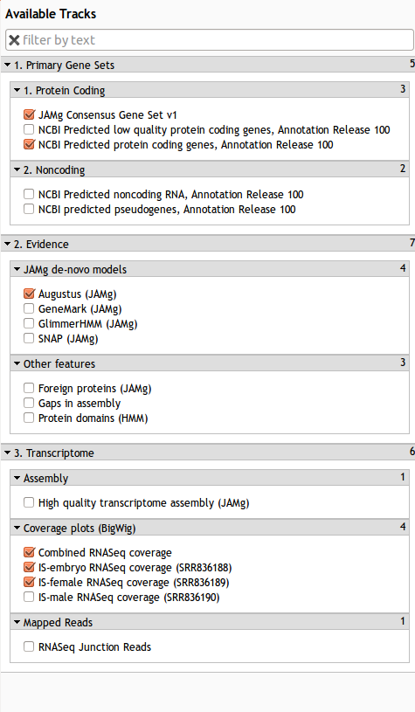
Evidence tracks
Genome
Was downloaded from here. It is using the official NCBI RefSeq accessions (not GenBank GI accessions)
“Primary gene sets”
NCBI made a prediction with RNA-Seq data from Baylor
‘protein coding genes’
‘low quality protein coding genes’
Noncoding RNA (tRNA and rRNA predictions
Pseudogenes (like proper genes but in-frame stop codons)
Alexie made a prediction using JAMg and RNA-Seq from Baylor and our German collaborators
I didn’t do any non-coding RNA predictions as they would be identical to NCBIs (we use the same tools)
No pseudogenes were predicted – at least there shouldn’t be.

Slide 45
Evidence tracks
“Evidence”
These are data were used by JAMg to make a decision on whether there is a gene.
“Foreign proteins” are RefSeq Insect alignments to the genome
“Gaps in the assembly” is simply a track that appears black if the genome has NNs
“Domains” are hidden markov profile of the SwissProt database against the genome
“RNAseq”
We had some libraries from German collaborators that they agreed to share for annotation as long as we didn’t share the raw data.
The combined RNASeq coverage includes the Baylor and German data into a coverage track.
IS-embryo, IS-female and IS-male tracks are the ‘Baylor’ data (as created by our Italian collaborators). The raw data is available from NCBI.
We also provide the alignments of a Trinity de-novo + Trinity genome-guided + PASA2 assembly of all the RNA-Seq data. These are then aligned using exonerate with very stringent settings.
“Mapped reads”
We took all the RNASeq (Italian and German) and provide a BAM track of the reads that span an intron / exon junction. They are very useful in determining if two exons are really linked
All of these data were used to inform the JAMg annotation, and we provide them to you so you can manually check if you want to. Let us know if you need any other tracks.

Slide 46
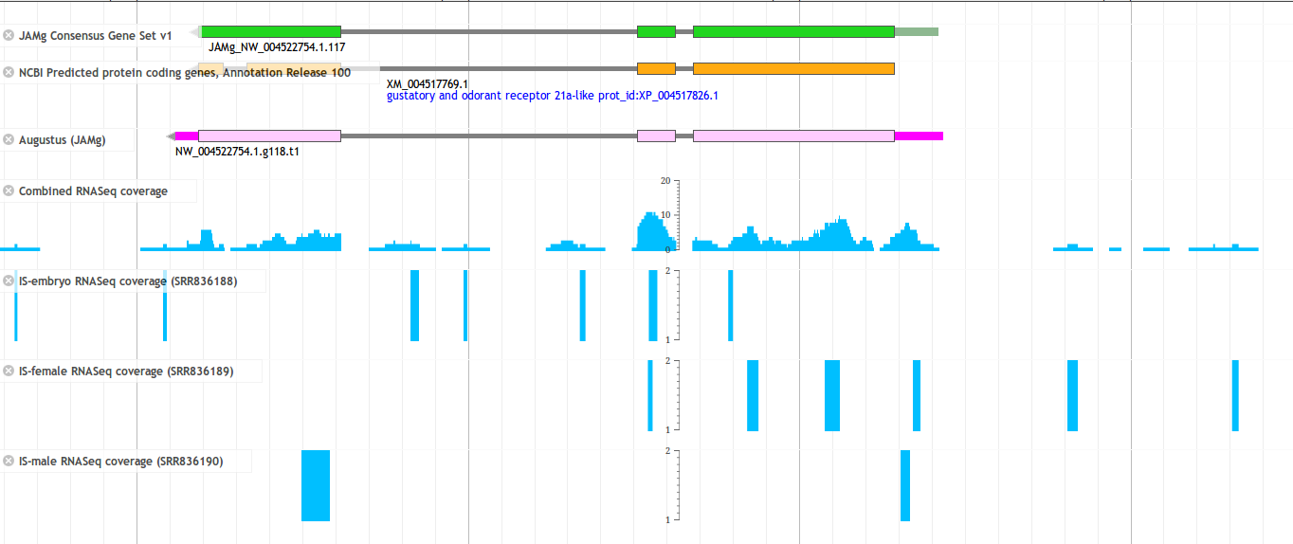
RNASeq
These are alignments of the ‘raw’ reads against the genome, and then a coverage graph is shown to help you understand if a particular base is expressed.
There is one track for each library and also a track with all the libraries aggregated.
Use the library-specific tracks if you want to see specific expression data and understand its expression profile.
Use the combined all-library track to see if a base is expressed at all.
The all-library track includes data which we cannot share. It is very useful however as you can see from this model.
The basic configuration of these tracks is determined by Monica and Chris. Please let them know if you prefer a different view

Slide 47
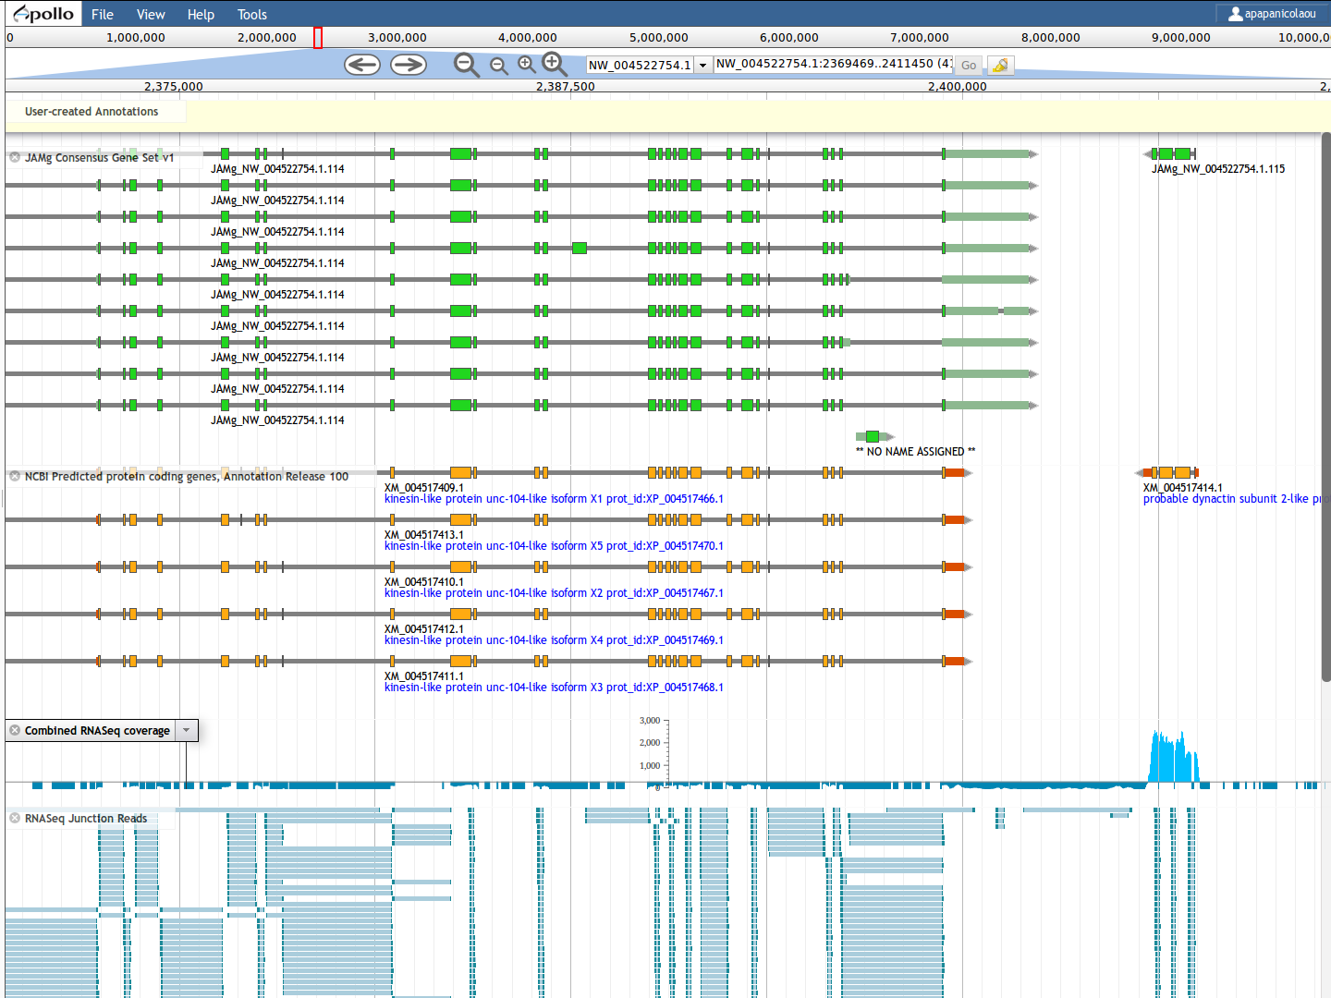
Changing a tracks configuration
You can change the track configuration yourself using the browser.
Click on the arrow next to the name.

Slide 48
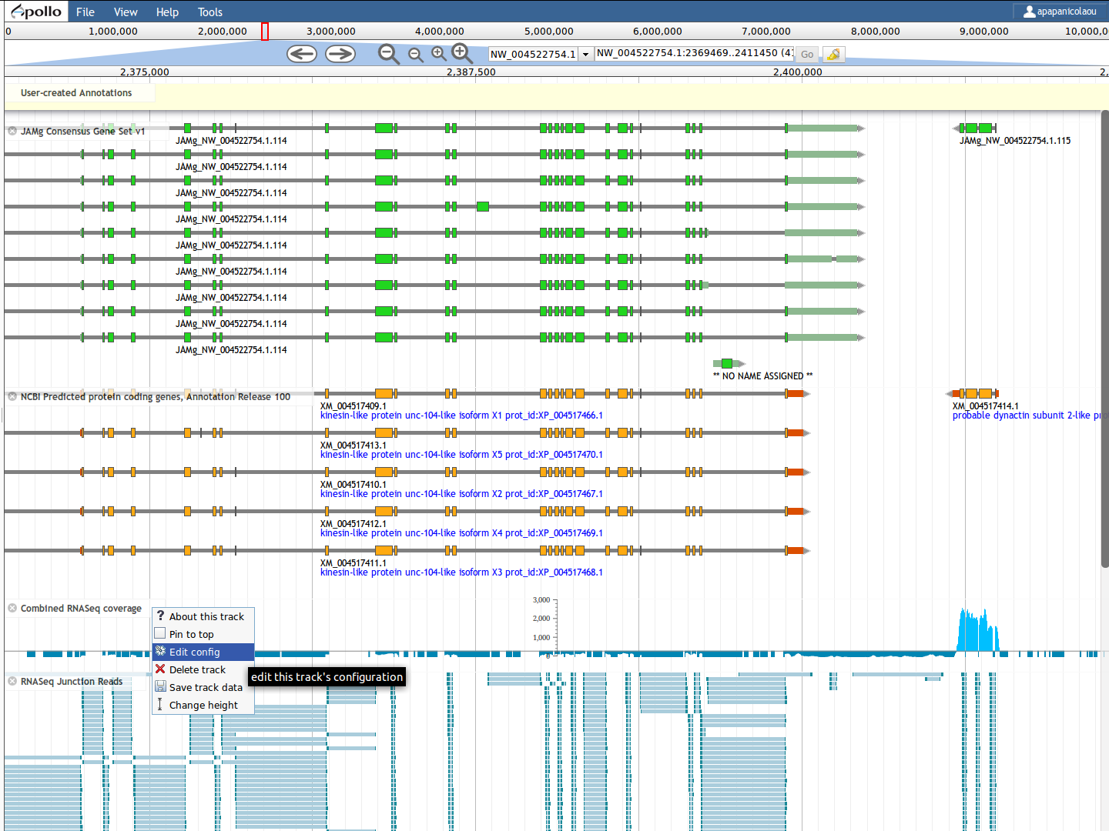
Changing a tracks configuration
In the drop down menu, select edit config.
The configuration guide is available here but let’s change to add a logarithmic scale.

Slide 49
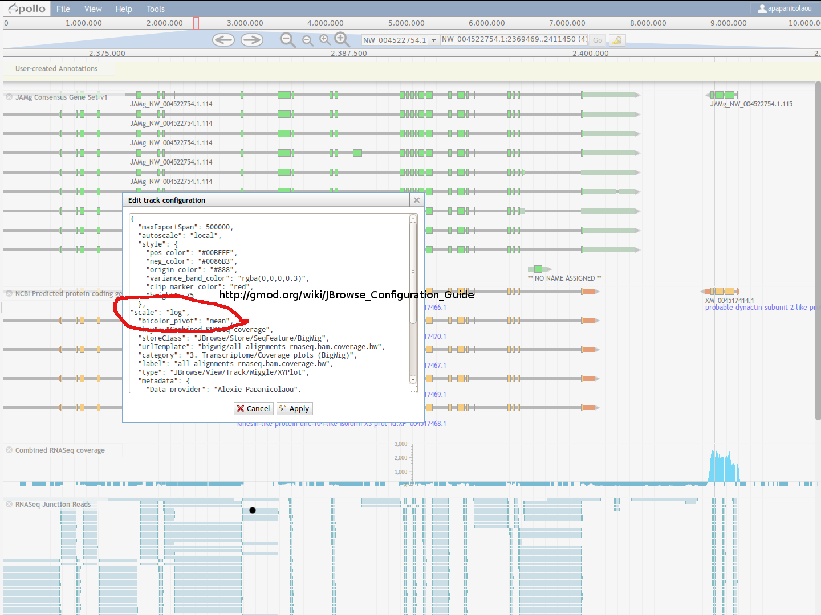
Changing a tracks configuration
A text box will appear, in the so called JSON format.
You can add this line:
“scale”:”log”,
Note that the the comma and double quotes are needed.

Slide 50
Alignments
We provide “RefSeq insects” (foreign proteins) but have not provided any other alignments from any genomes (e.g. tblastx) or gene families
But we could do if you let Alexie know or you can upload your own data if you have them and know how (e.g. BAM or GFF files)
We (or you) could make alignments of specific gene families and they we can both visualize them against the genome and create a ‘profile alignment’ for you to use with our webservice.

Slide 51
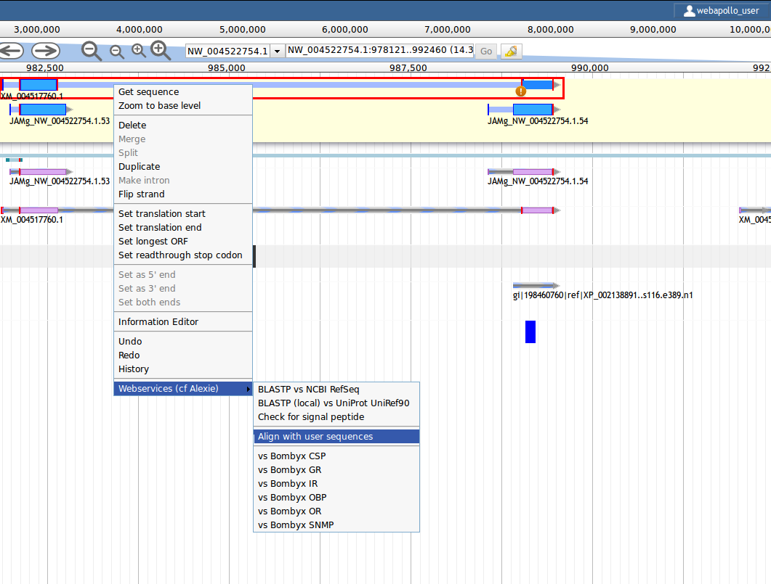
Webservices: alignment
You can access the webservices by right clicking on a curation track gene and selecting Webservices.
These include Alignment, signal peptides and BLAST (the latter is quite slow as it is a large database).
These tools use the sequence as it is currently edited. This means you can make a change and then re-run the webservice.

Slide 52
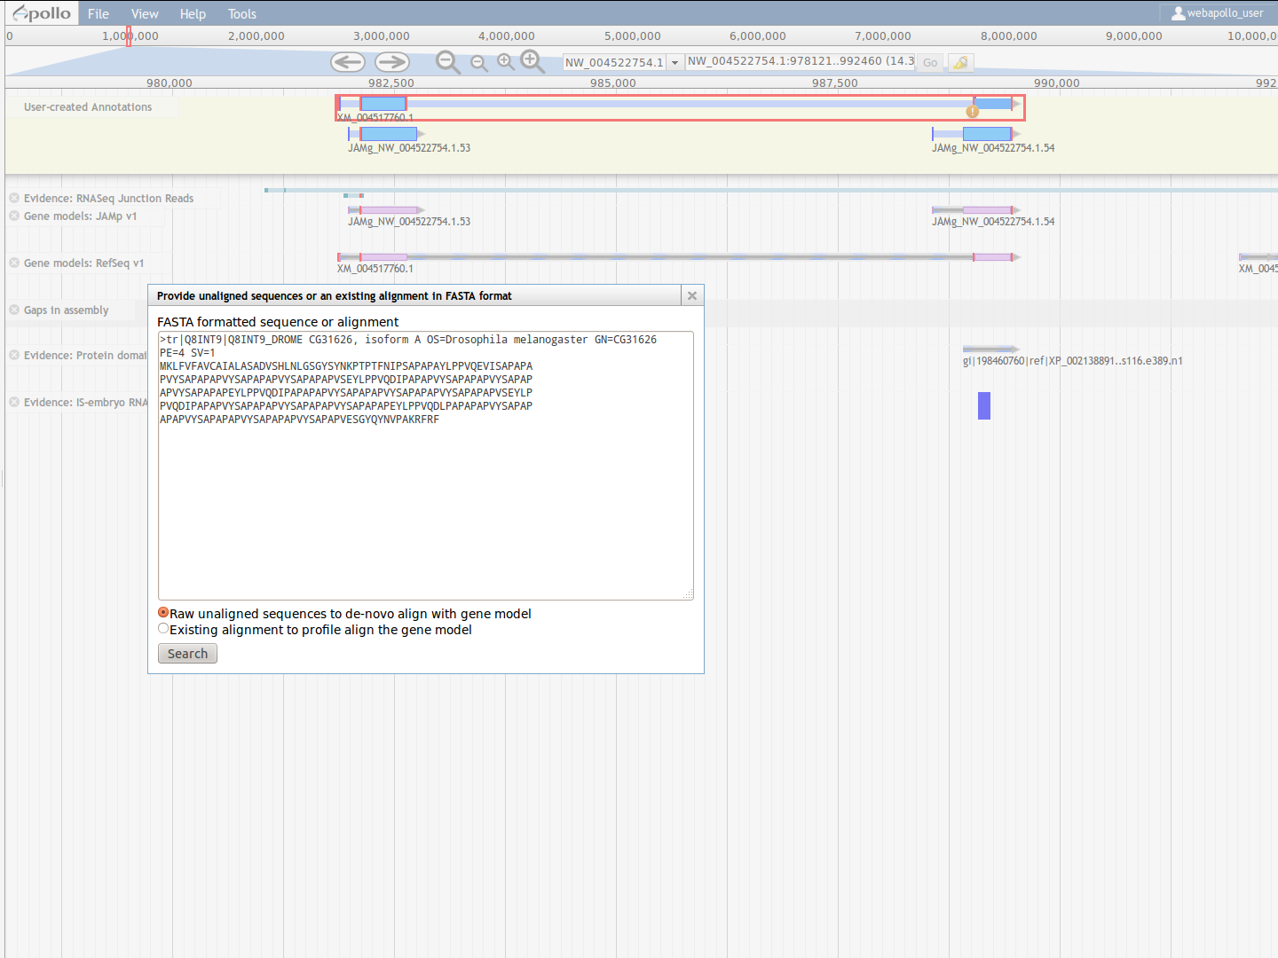
Webservices: alignment
If you select align with user sequence then you have two options:
Copy paste a raw sequence: the program (MAFFT) will align it against the curated gene
Copy paste a multiple sequence alignment in FASTA format. This will do a profile alignment (i.e. try to align your curated gene with your alignment). We found this facility really useful for looking for missing exons

Slide 53
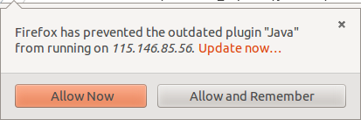
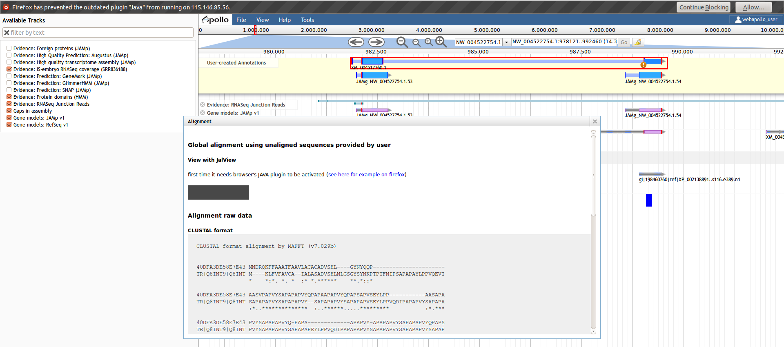
Webservices: alignment
The resulting alignment is returned quite quickly. First you will see it in CLUSTAL format and below that in FASTA format (so you can copy paste it to your favourite tool).
However, a powerful way to view the data is using a JAVA applet called JalView
You will have to have JAVA installed on your compturer. Sadly JAVA has been misused by hackers so all browsers are now very careful about JAVA. You will have to permit your browser to run it.

Slide 54
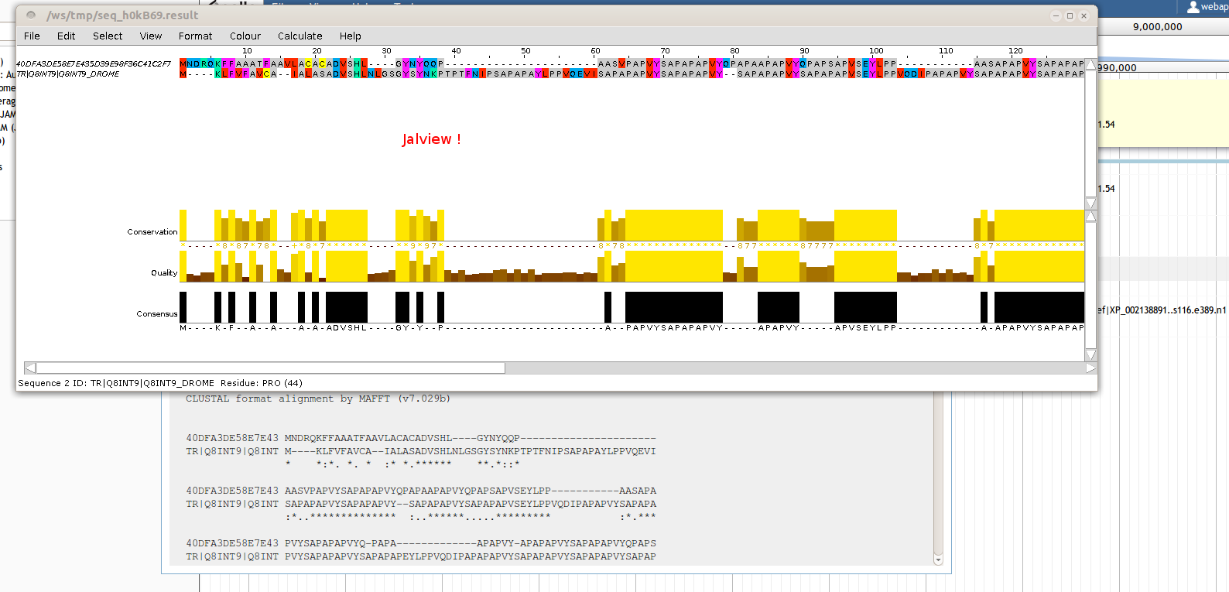
Webservices: alignment
In theory you only need to authorise this once (for every computer).
Jalview is a pretty powerful visualisation system, allowing you to cluster by identity, make trees and many many other things.
It works best if you have a multiple sequence alignment (e.g. a gene family or a gene from many species). Here however you can see that Drosophila seems to have 20 extra amino acids: are these really meant to be missing or is there a missing exon?

Slide 55
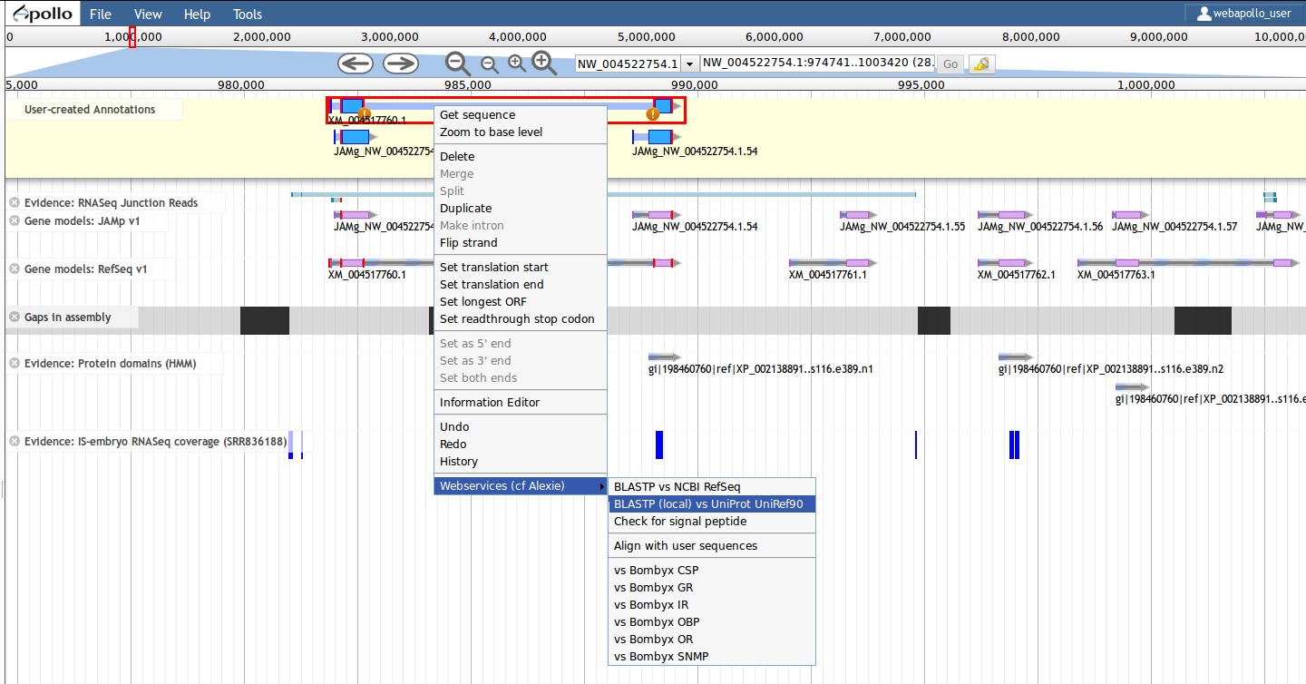
Webservices: BLAST
You can also do a BLASTP against Uniprot90 or the NCBI database. For the latter you can do it ‘remotely’ (i.e. The NCBI server) or locally.

Slide 56
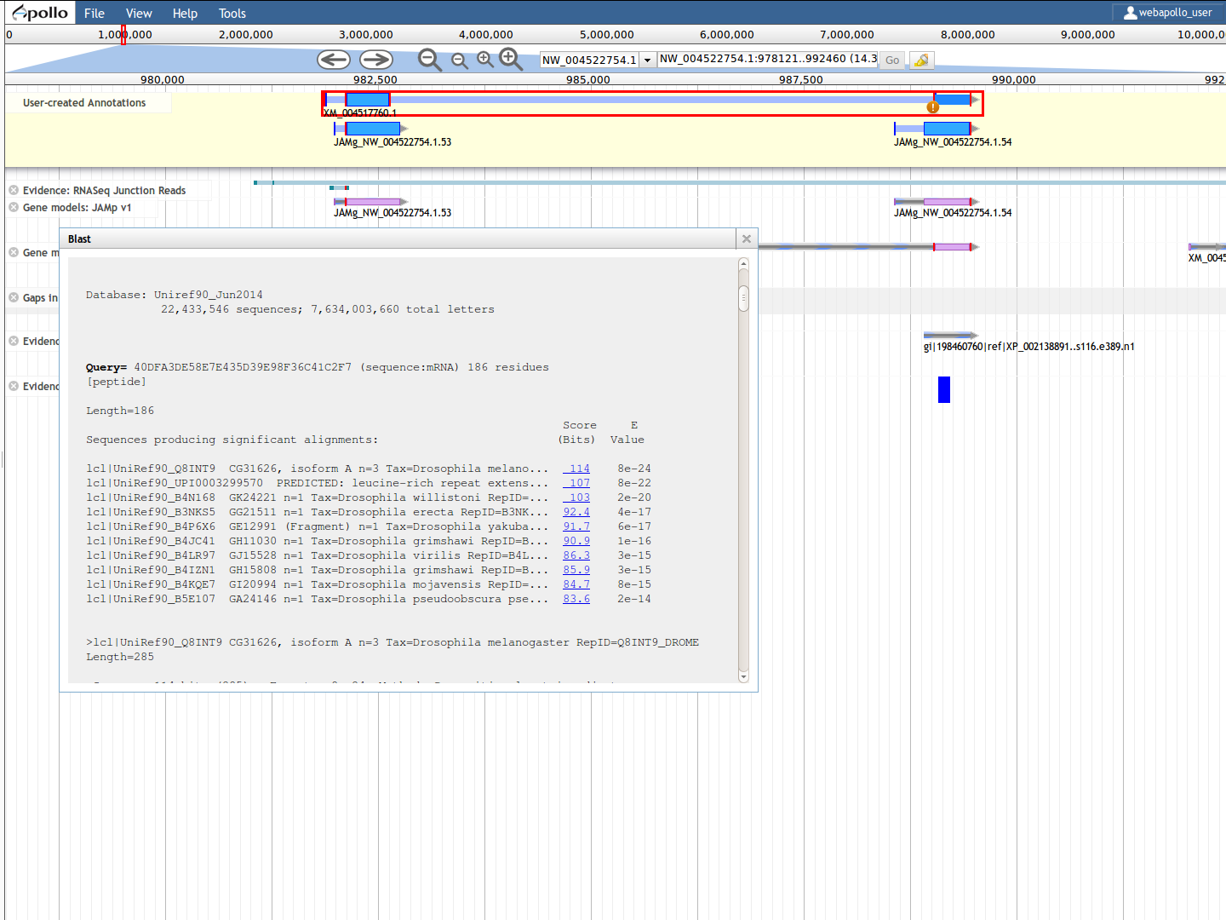
Webservices: BLAST
Sadly BLASTP searches are slow against these massive databases.
But it is convinient in some cases.
If you want us to use the Drosophila proteome we could do that too (or other genome). Then the BLASTP will be much much faster

Slide 57
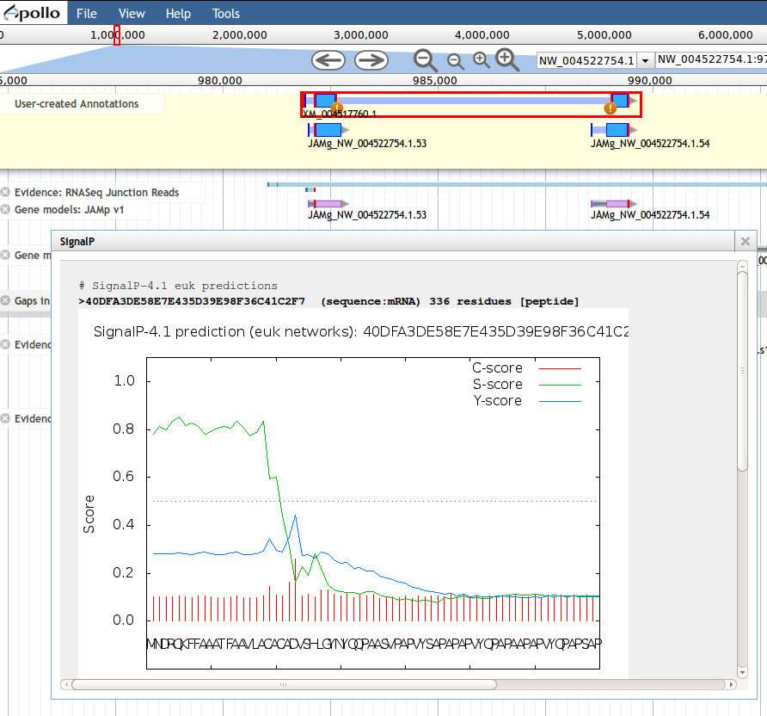
Webservices: Signal Peptide
You can search for a signal peptide using signalP.
C-score (raw cleavage site score):The output from the CS networks, which are trained to distinguish signal peptide cleavage sites from everything else.
Note the position numbering of the cleavage site: the C-score is trained to be high at the position immediately after the cleavage site (the first residue in the mature protein).
S-score (signal peptide score): The output from the SP networks, which are trained to distinguish positions within signal peptides from positions in the mature part of the proteins and from proteins without signal peptides.
Y-score (combined cleavage site score): A combination (geometric average) of the C-score and the slope of the S-score, resulting in a better cleavage site prediction than the raw C-score alone. This is due to the fact that multiple high-peaking C-scores can be found in one sequence, where only one is the true cleavage site. The Y-score distinguishes between C-score peaks by choosing the one where the slope of the S-score is steep.
In the summary below the plot, the maximal values of the three scores are reported. In addition, the following two scores are shown:
mean S: The average S-score of the possible signal peptide (from position 1 to the position immediately before the maximal Y-score).
D-score (discrimination score): A weighted average of the mean S and the max. Y scores. This is the score that is used to discriminate signal peptides from non-signal peptides.
For non-secretory proteins all the scores represented in the SignalP output should ideally be very low (close to the negative target value of 0.1).

Slide 58
Ok, so how do I start curating!?
There are a number of ways to find the gene region you wish to annotate. It depends what you’re starting with:
The protein sequence from another species
Sequence from a similar gene
You provided Alexie with golden genes and he provided back alignments
You provided Alexie with high quality proteins and/or gene family alignments (multi or single species) and he created domain annotations.
Option 3 – Get genes based on a GO / EC etc term
This is a fun new tool Alexie has made, described in the next slide and called Just_Annotate_My_proteins.
You basically just pick a Gene Ontology, Enzyme, KEGG etc term and it gives you a list of genes that have a significant Hidden Markov Model alignment to a SwissProt protein (i.e. only real proteins that have been validated) and that has real experimental evidence (i.e. from the literature) for that term.
The search is conservative because I didn’t allow the so called IEA evidence codes, to avoid propagating annotation errors (see genome annotation lecture). However, the search is run twice: first every annotated gene is searched against SwissProt. Then a profile alignment is created with the good matches and searched again.
Option 1 – You have a sequence but don’t know where it is in this genome
You will need to BLAT it
If protein-based BLAT doesn’t find it, you can BLAST it
You can use the i5k BLAST server here : http://i5k.nal.usda.gov/blastn
Or you can use any other tool, for example Geneious
Option 2 – the genome has already been annotated with your sequences and you have an ID
In other words, someone has told you where to look: if you give Alexie profile alignments of your fav. gene family we could do that for you.
Type the ID in the Search box of WebApollo
WebApollo autocompletes using a case-insensitive search anchored on the left-hand side of the word
e.g. so HaGR will show all hagr objects (up to 10)
Choose one of the gene and click Go
You can do that with Domains, Alignments or Gene names provided to you.

Slide 59
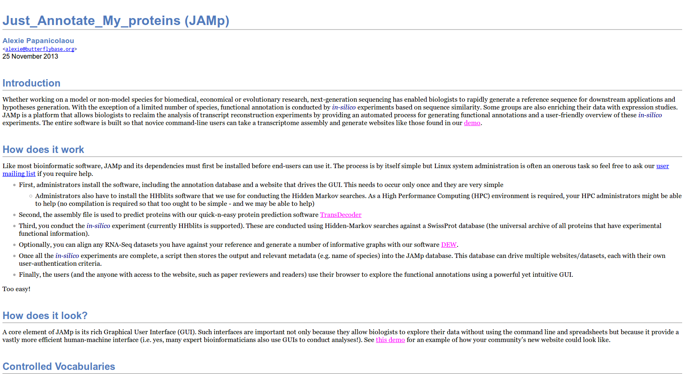
Just_Annotate_my_Proteins (JAMp)
JAMp is freely available for any bioinformatics team from http://jamps.sourceforge.net
It is a research software (i.e. not commercial with a dozen software engineers) so your feedback and patience are appreciated.
It is tested on Firefox but will work on IE10+, Chrome, Windows, Linux and OSX. Documentation is not currently great but this manual explains everything you will need (let me know if not).

Slide 60
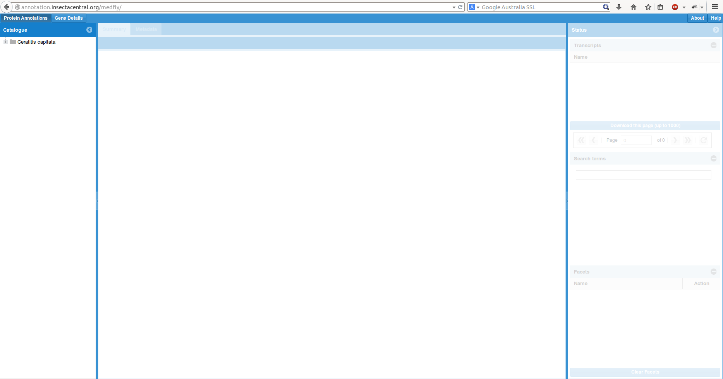
Just_Annotate_my_Proteins (JAMp)
I have prepared a JAMp for Medfly: http://annotation.insectacentral.org/medfly
The username:password is: medfly:florid@67
The german collaborators have a different instance that also has their RNA-Seq expression data (ask Alexie for password)
On the left-hand side is a list of species (one for your consortium). Click on it to reveal list of genome annotations that have been run.

Slide 61
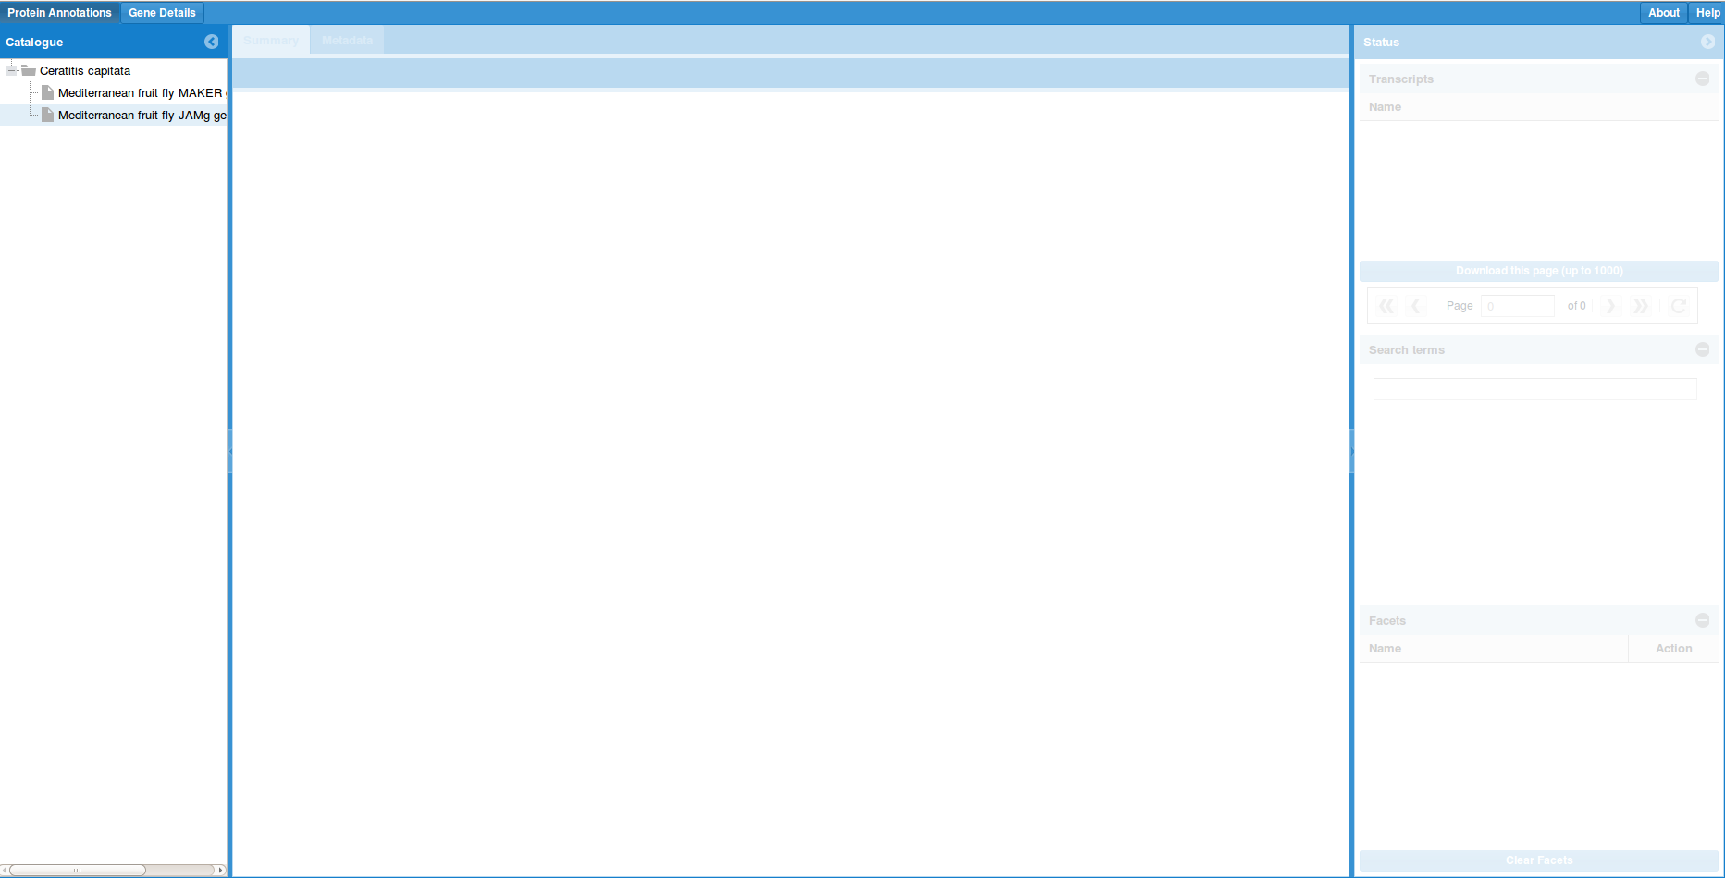
Just_Annotate_my_Proteins (JAMp)
Currently we have added three gene predictors (the pictures are before we processed NCBI). The MAKER dataset turned out to have errors so we do not load it on Web Apollo.
Select one or more datasets. To select multiple ones use the Ctrl key (for Windows/Linux and whatever is equivalent in OSX).

Slide 62
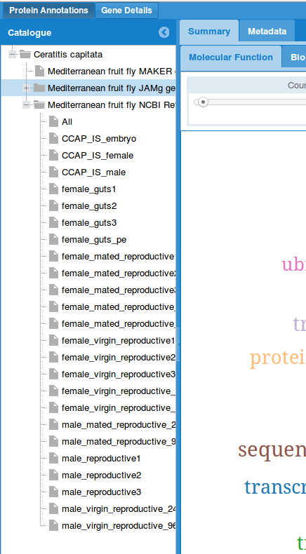
Just_Annotate_my_Proteins (JAMp)
When you select a dataset, you will see a list of “expression libraries”.
These are RNA-Seq libraries aligned to your genes.
This example is based on the german data because they have such nice data. If you have RNA-Seq we could add them here.
For the next slides, there is no reason to select a library. We will talk about expression later.

Slide 63
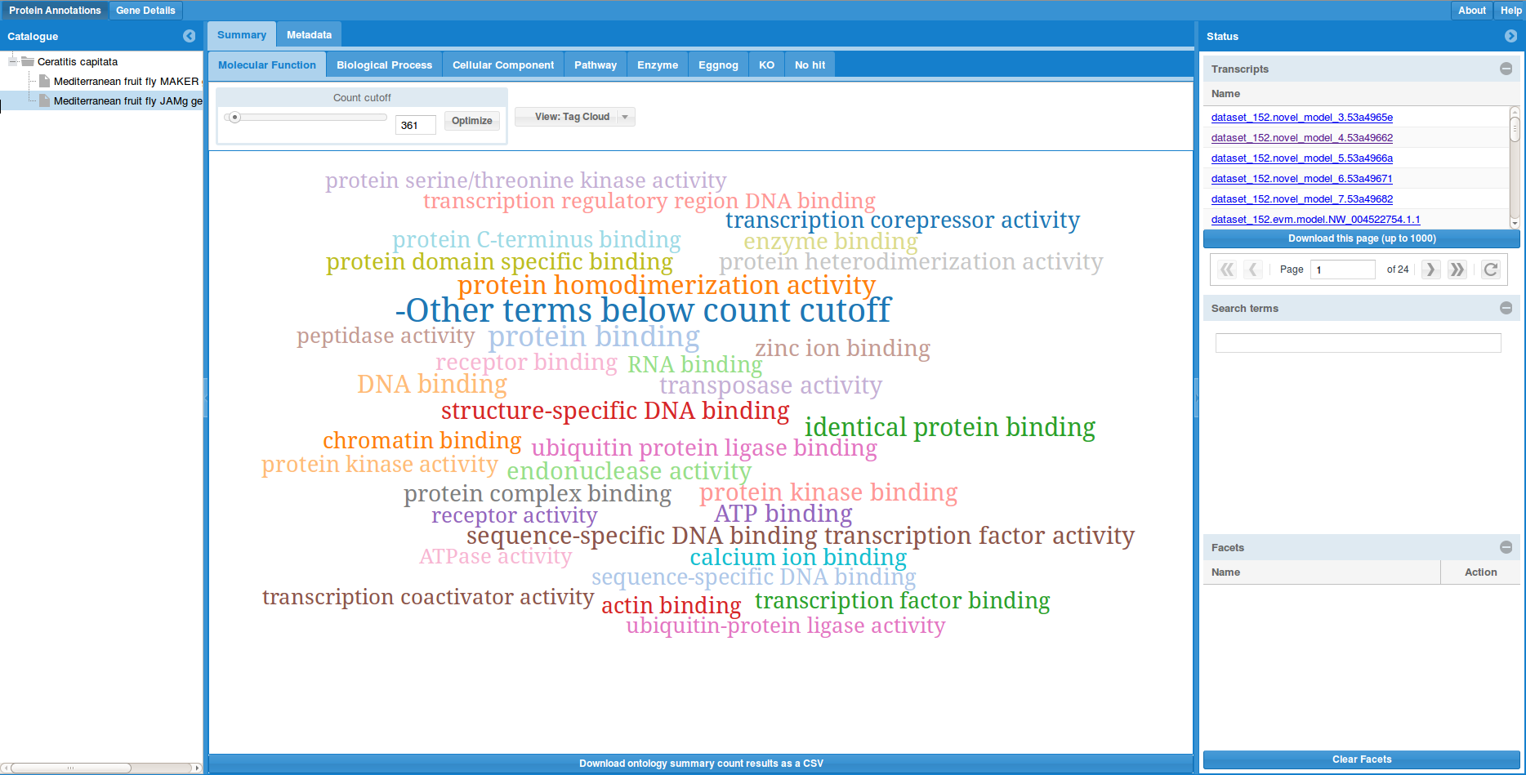
Just_Annotate_my_Proteins (JAMp)
Enzyme Classification terms
Once you select one or more, the software will query the database for the select CV and display a Tag Cloud with the hits above a threshold cut-off.
We currently support all CVs that supported by UniProt.org. Remember, these annotations come directly from SwissProt, i.e. manually curated genes from known proteins.
The 3 GO CVs
KEGG pathway
KEGG orthology
Controlled vocabularies
EMBL’s Eggnog (slow sadly)

Slide 64
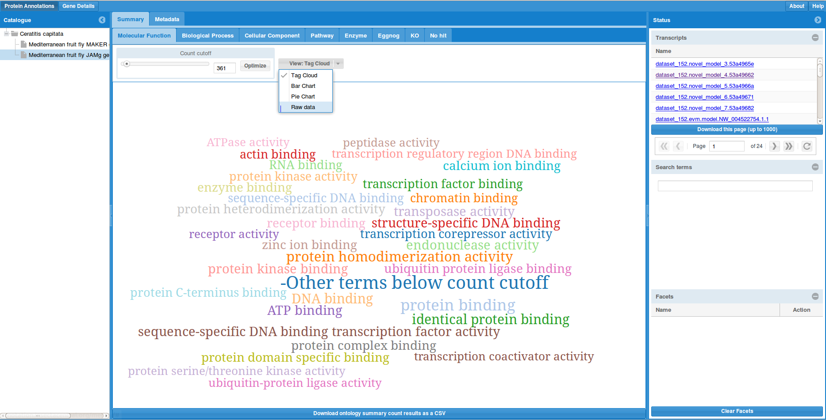
Just_Annotate_my_Proteins (JAMp)
We provide a number of visualizations, not all of which are meant for gene annotation.
Click on the arrow to select them.
The Raw Data is particularly useful because it gives a list of every term (i.e. the cut-off can go as low as 1).

Slide 65
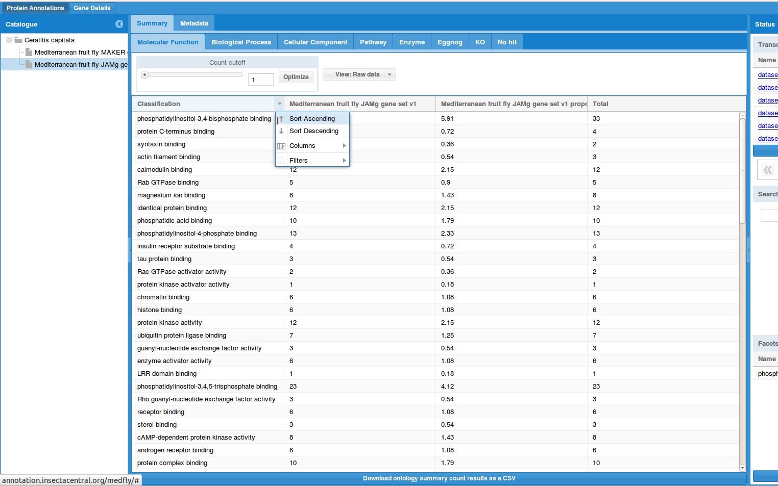
With Raw Data you can sort by any column, for example name or counts.
Counts is essentially how many proteins (genes) have been found in the dataset with that CV term.

Slide 66
Just_Annotate_my_Proteins (JAMp)
Regardless which view you select, the software allows you to ‘Facet’, i.e. select a term (via the graphics or the ‘Raw data’) and it will then only show the proteins that have that term.
For example, click on protein binding from the Molecular Function CV.

Slide 67
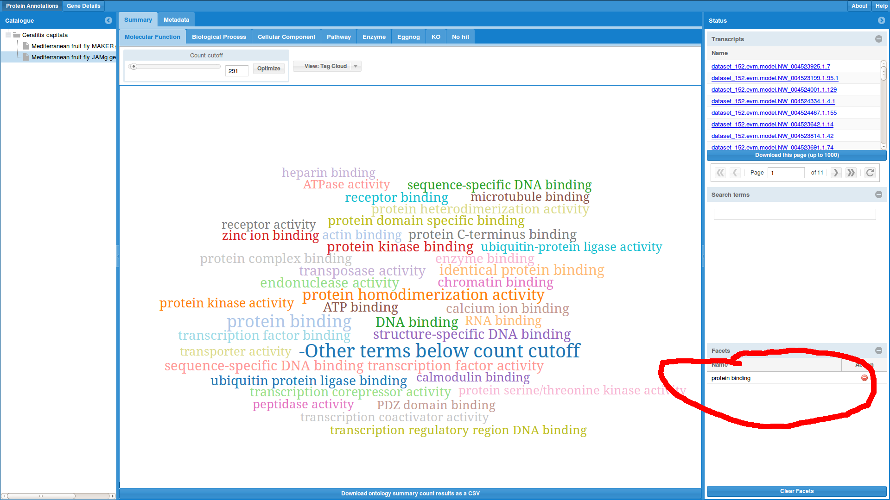
Just_Annotate_my_Proteins (JAMp)
This will now ‘Facet’ on protein binding (bottom right window will display it) meaning that the transcript list will only have genes that have protein binding.
The CV terms now displayed (and you can change between vocabularies) are only those available for proteins that ALSO have a Molecular Function protein binding link.
If no facet is selected, then the transcript list just shows all genes.
List of transcripts with facet

Slide 68
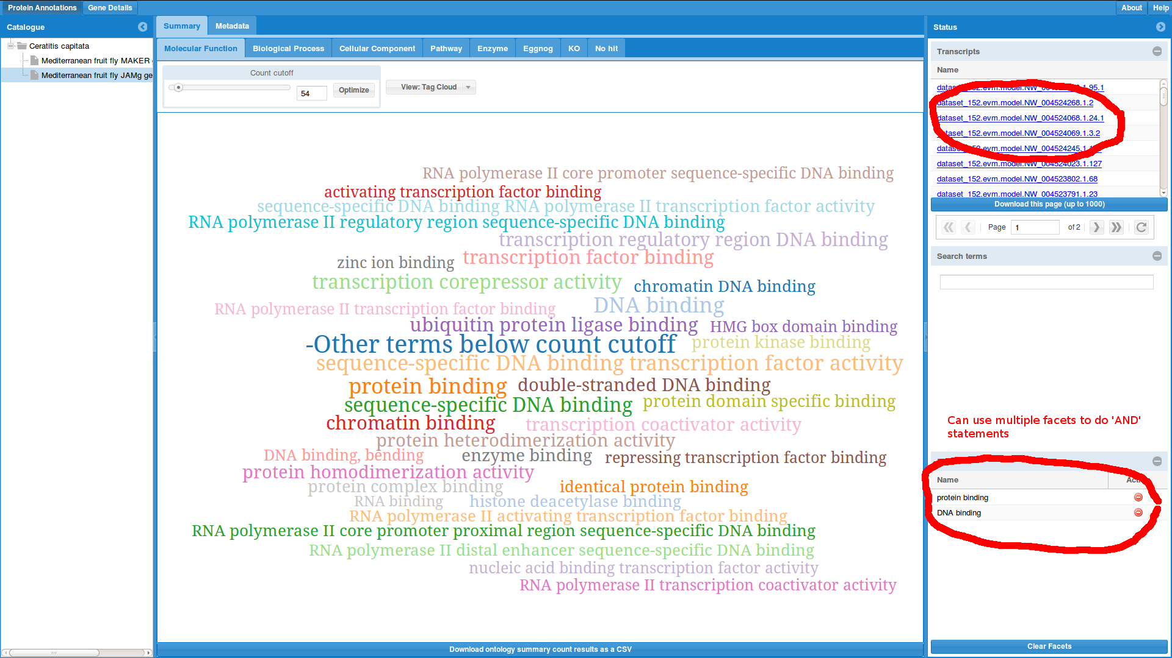
Just_Annotate_my_Proteins (JAMp)
So select DNA binding. Now you will have two facets, DNA and protein binding.
The search is a boolean AND. So the transcript list is therefore populated with genes that have both protein AND DNA binding. In other words, you have candidate transcription factors.
You can download a FASTA using the download button. For performance reasons, it currently downloads up to 1000 genes, so you will have to click on the ‘next page arrow’ to get the next 1000.
Download FASTA of this list of genes.
Next page

Slide 69
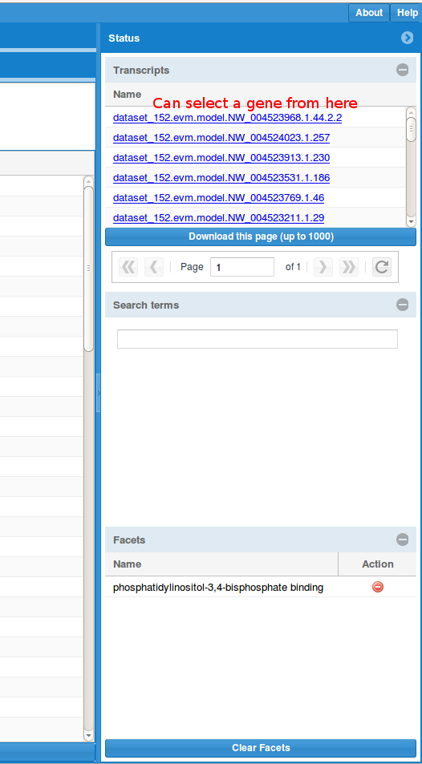
Just_Annotate_my_Proteins (JAMp)
This list of genes is clickable to go to the particular gene details.
Tip: In Firefox, you can shift-click to open a new tab so you keep your main view.

Slide 70
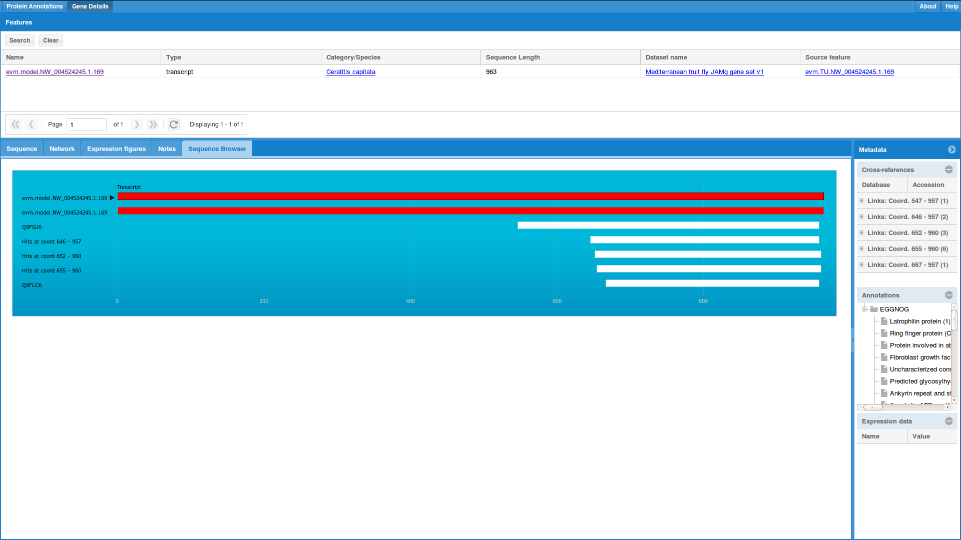
Just_Annotate_my_Proteins (JAMp)
The gene details view is a rich interface where we store all sorts of data (for all sorts of projects).
It is divided in three main views, called panels: Graphics, Metadata, gene list.
The Graphics panel has a number of tabs for visualising different types of data. The Metadata panel has 3 lists: cross-references (clickable links to other databases), a list of the annotations found for this gene, and if available the expression data as predicted by DEW (http://dew.sourceforge.net).
Gene list panel
Metadata panel
Graphics panel

Slide 71
Just_Annotate_my_Proteins (JAMp)
The Gene List allows you to go to the source feature, i.e. for a transcript that will be the gene
The Sequence Browser shows the transcript and any SwissProt (Uniprot.org) hits and their co-ordinates.
The Graphics panel also supports the FASTA sequence of gene, transcript and protein; any network data we created (by default similarity clustering is made available) but these network graphics are currently rudimentary; Expression figures (see soon); and ‘Notes’, which once the Curation effort is complete will be the Comments you provided.
Gene list panel
Metadata panel
Graphics panel

Slide 72
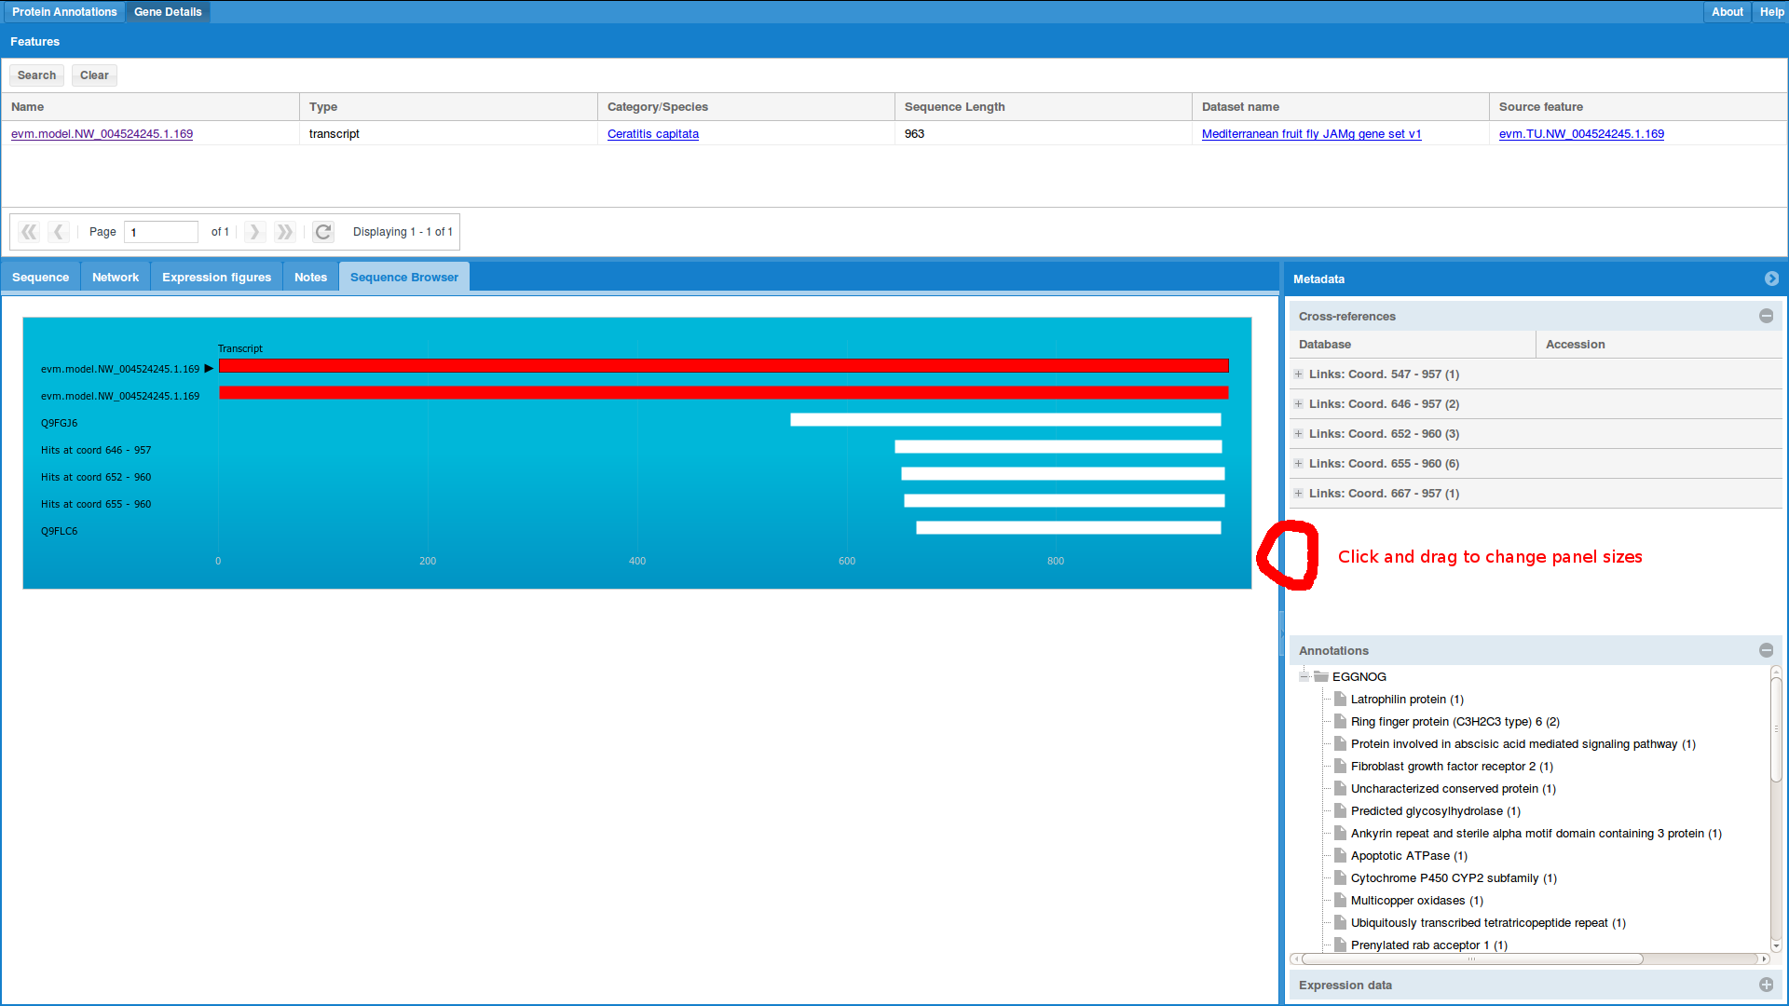
Just_Annotate_my_Proteins (JAMp)
Like the rest of JAMp, you can click and drag the various ‘dividers’ to resize the panels to your liking. Clicking on the arrows on the ‘titlebars’ allows you to collapse the panels.

Slide 73
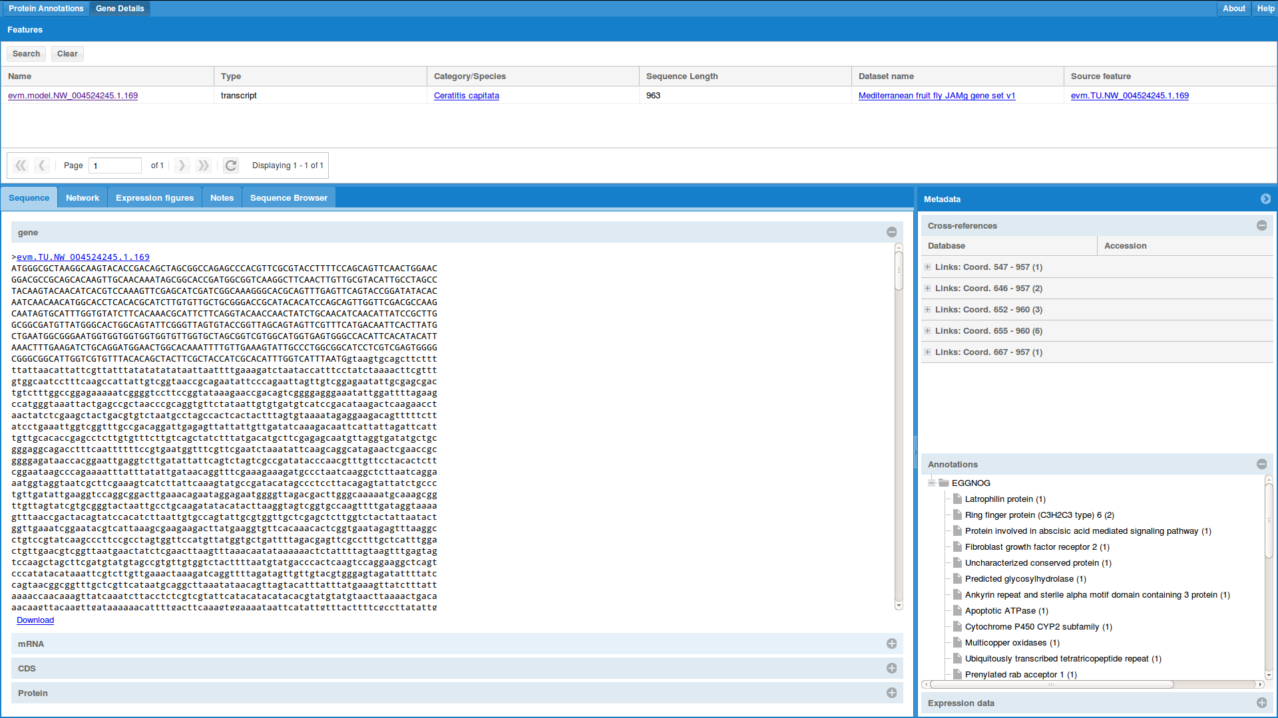
Just_Annotate_my_Proteins (JAMp)
The Sequence tab has the FASTA of the various parts of the feature, include the gene (includes introns shown as lower-case letters), mRNA (includes UTR), CDS and protein.

Slide 74
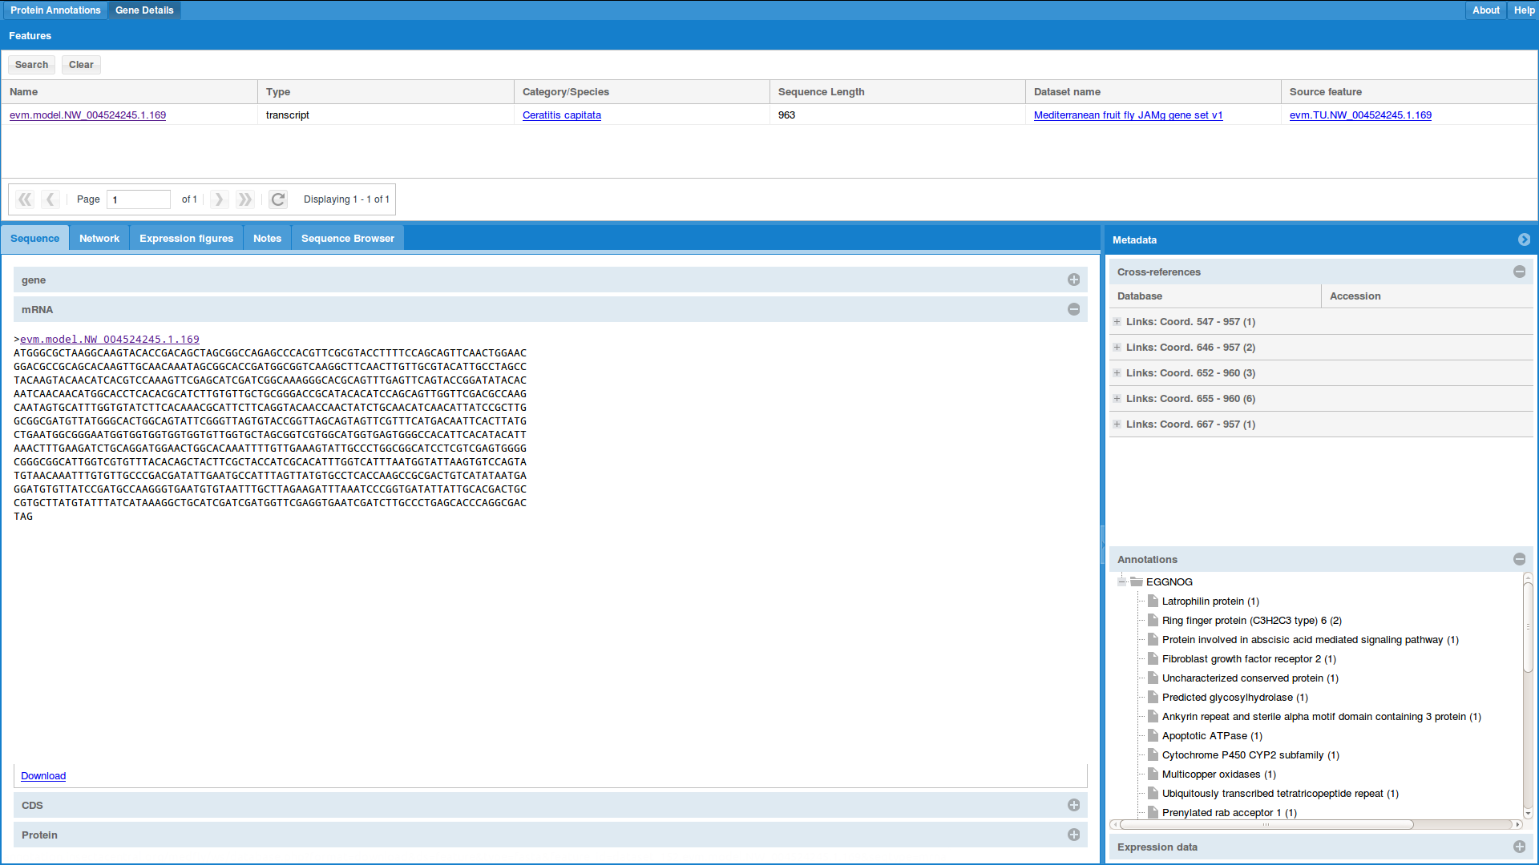
Just_Annotate_my_Proteins (JAMp)
You can use the ‘Download’ button to download them in FASTA format.
For the Protein sequence, you can select which translation table you’d like to use.

Slide 75
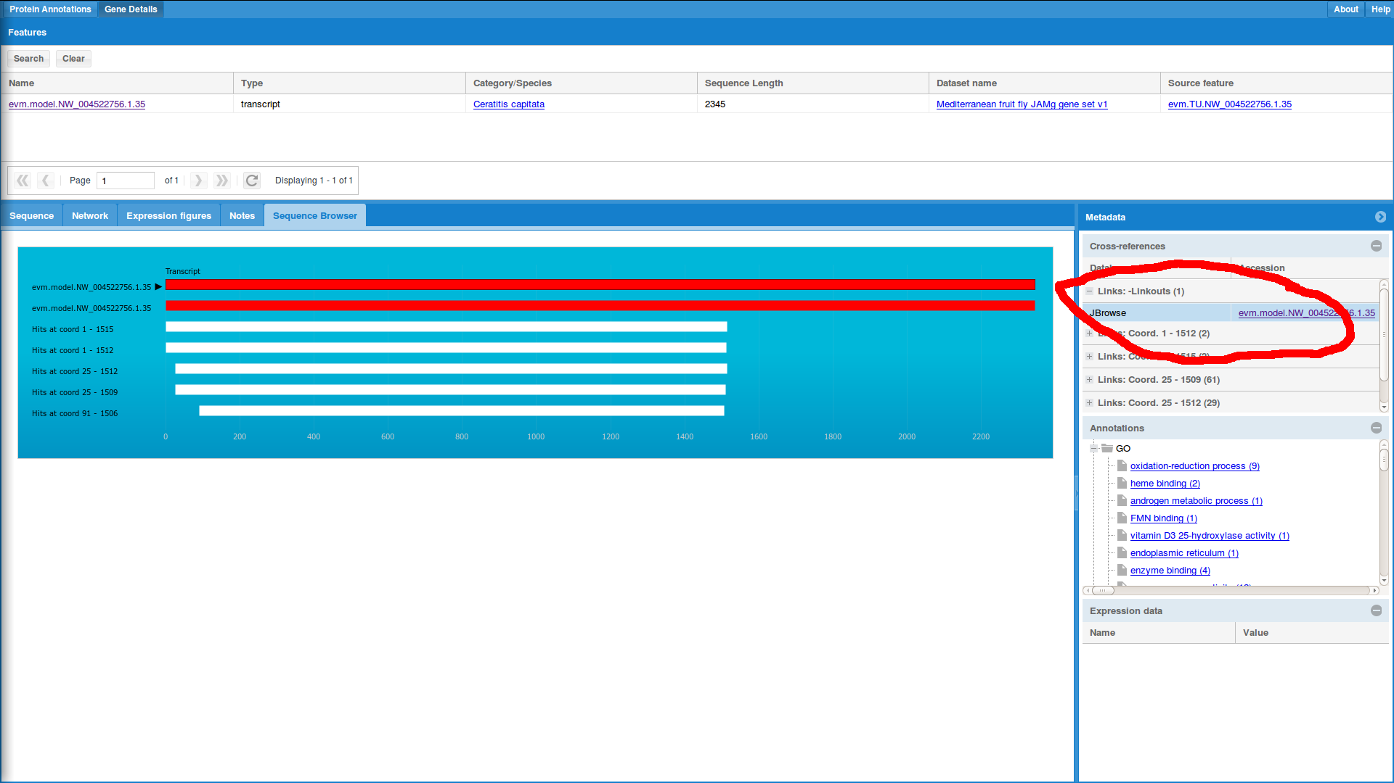
Just_Annotate_my_Proteins (JAMp)
For curation the important feature is on the Metadata panel. By clicking on ‘Links Linkouts’ you will get a way to go the Web Apollo and edit this gene.

Slide 76
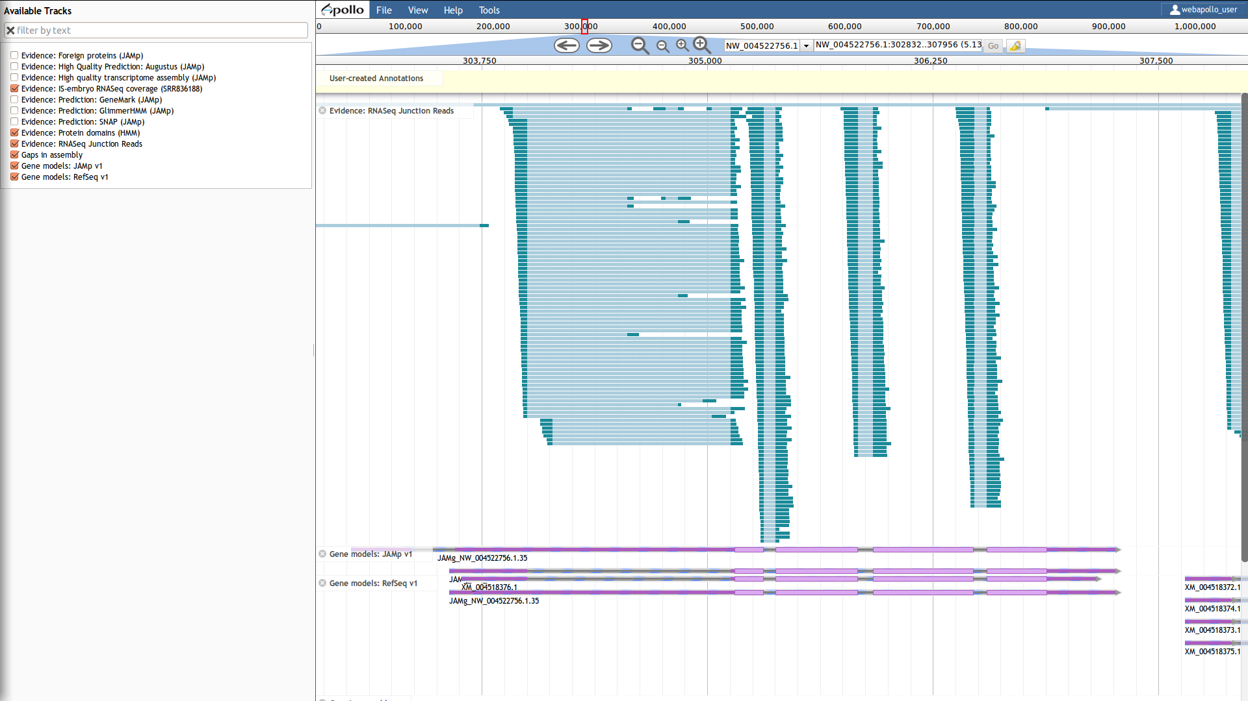
Just_Annotate_my_Proteins (JAMp)
Tada!
Now you can edit this gene (a CYP450 in this case).

Slide 77
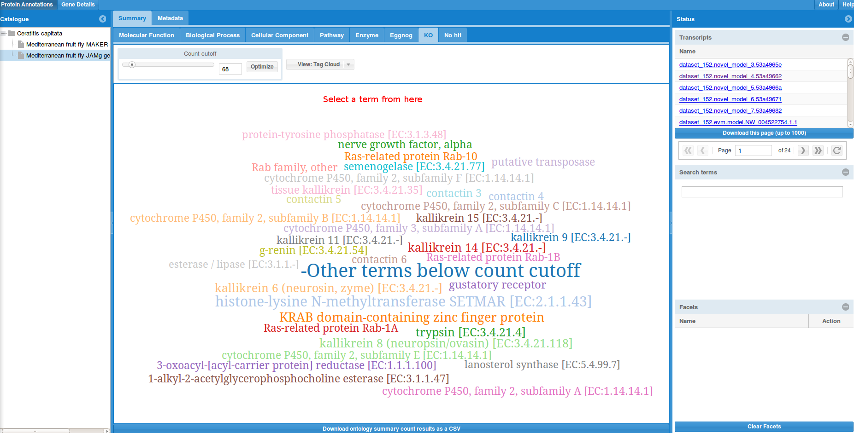
CYP450
Speaking of CYP450s, here is one way you can get
Select the KO CV (KEGG Orthology)

Slide 78
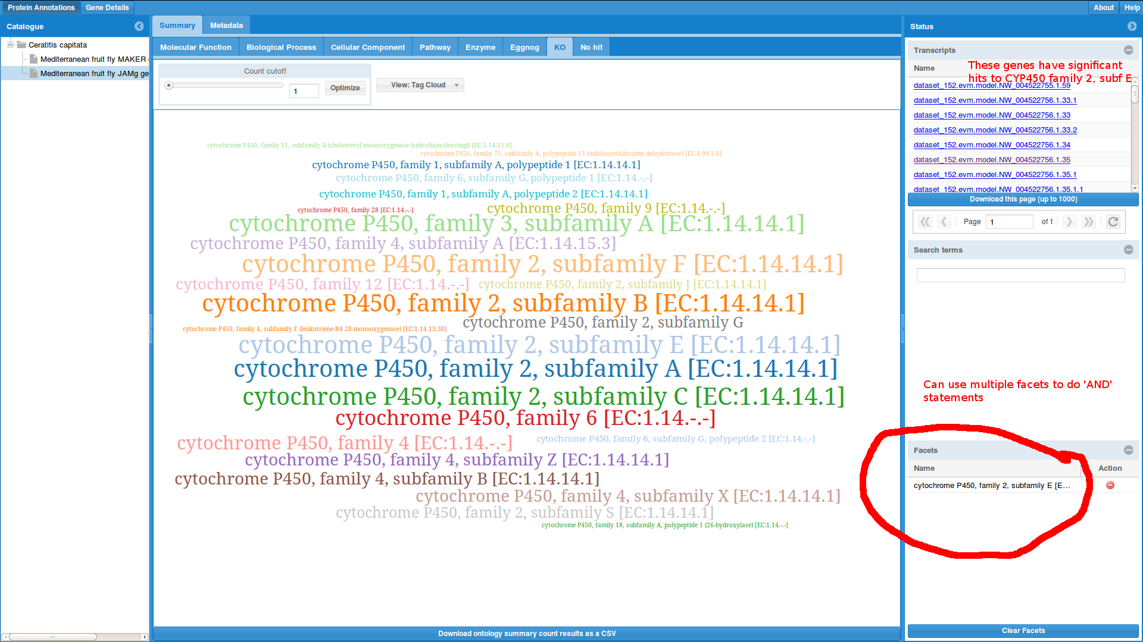
CYP450
Select which family you’d like to annotate (well, the genes may be similar enough to be annotated with multiple families – remember these are annotated are inferred via electronic similarity, not an experiment).

Slide 79
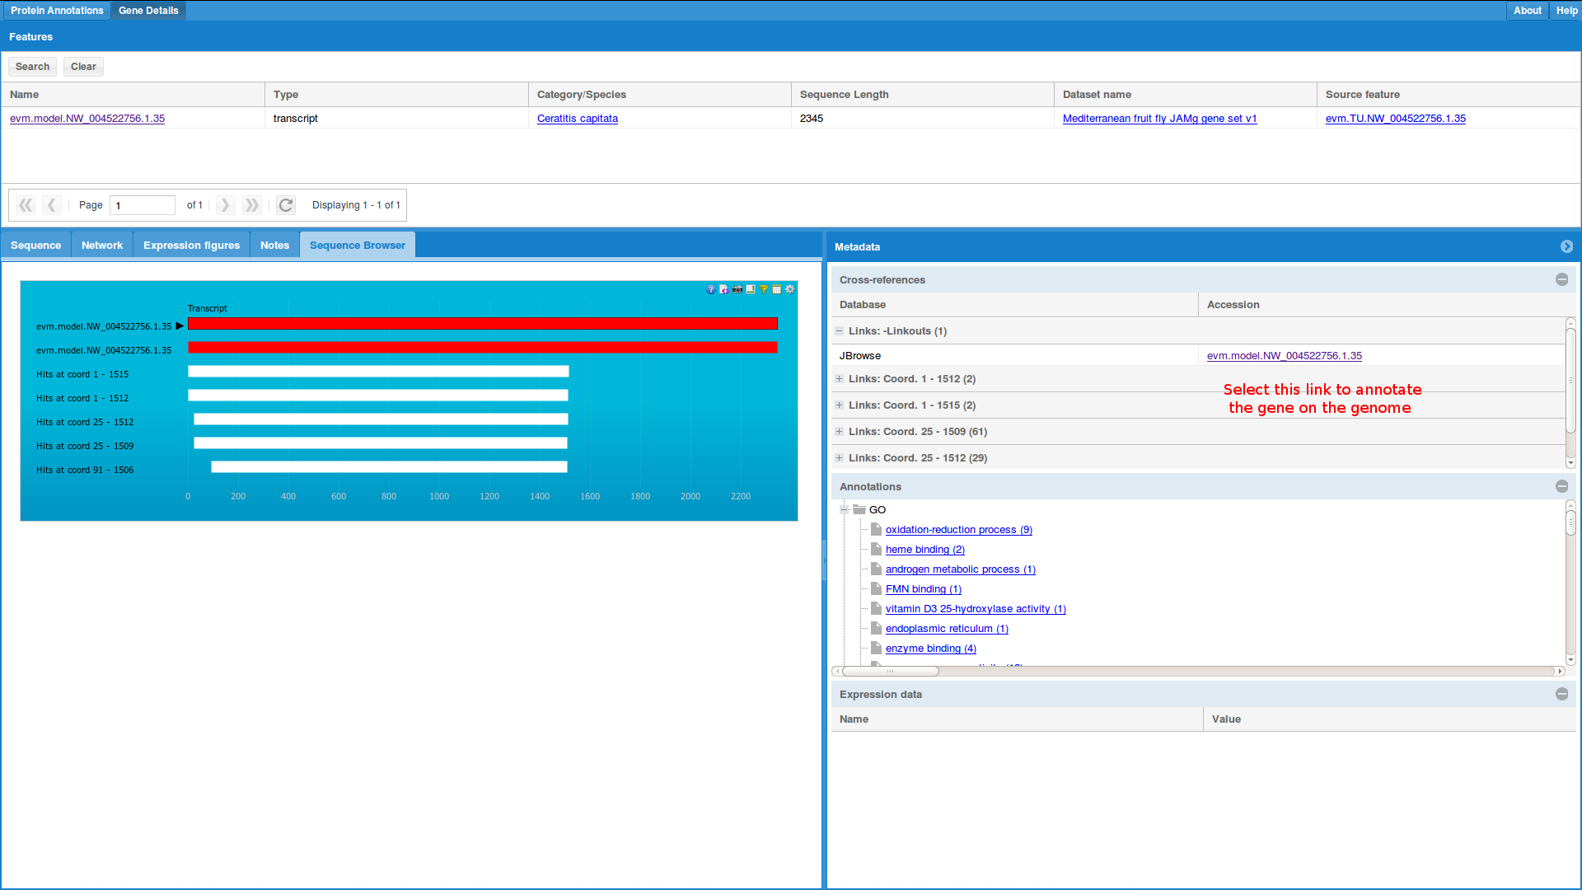
CYP450
You will then be able to click through every gene and link out to Web Apollo.
The ‘Annotations’ panel also has a list of other GO terms. If they are correct, this saves you the trouble of having to add them to Web Apollo as we will add them automatically.
You should still add any GO terms to Web Apollo if you’ve done an experiment yourself. These GO terms are IEA evidence.

Slide 80
Expression
The expression data may be useful for annotation but we think it is best used for downstream analysis.
You can mine using expression data in two ways:
You can select a library from the right. This will ‘facet’ based on whether the gene is expressed and will like any other faceting.

Slide 81
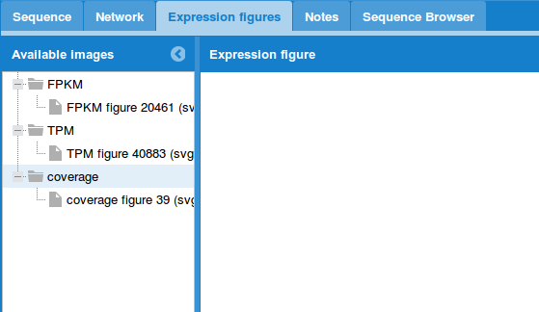
Expression
The other way is via Gene details page and the Expression tab.
The tab shows any available data. I’ve calculated FPKM, TPM and coverage (across the gene). Both the FPKM and TPM measures are done on normalized data so that they are actually comparable. So it is does not have the problems normally associated with FPKM.

Slide 82
Expression
The pipeline works like so:
Align reads
Use eXpress to account for Illumina and isoform biases. Each read is allocated to a single isoform
Normalize by library size
Normalize using edgeR’s TMM normalization

Slide 83
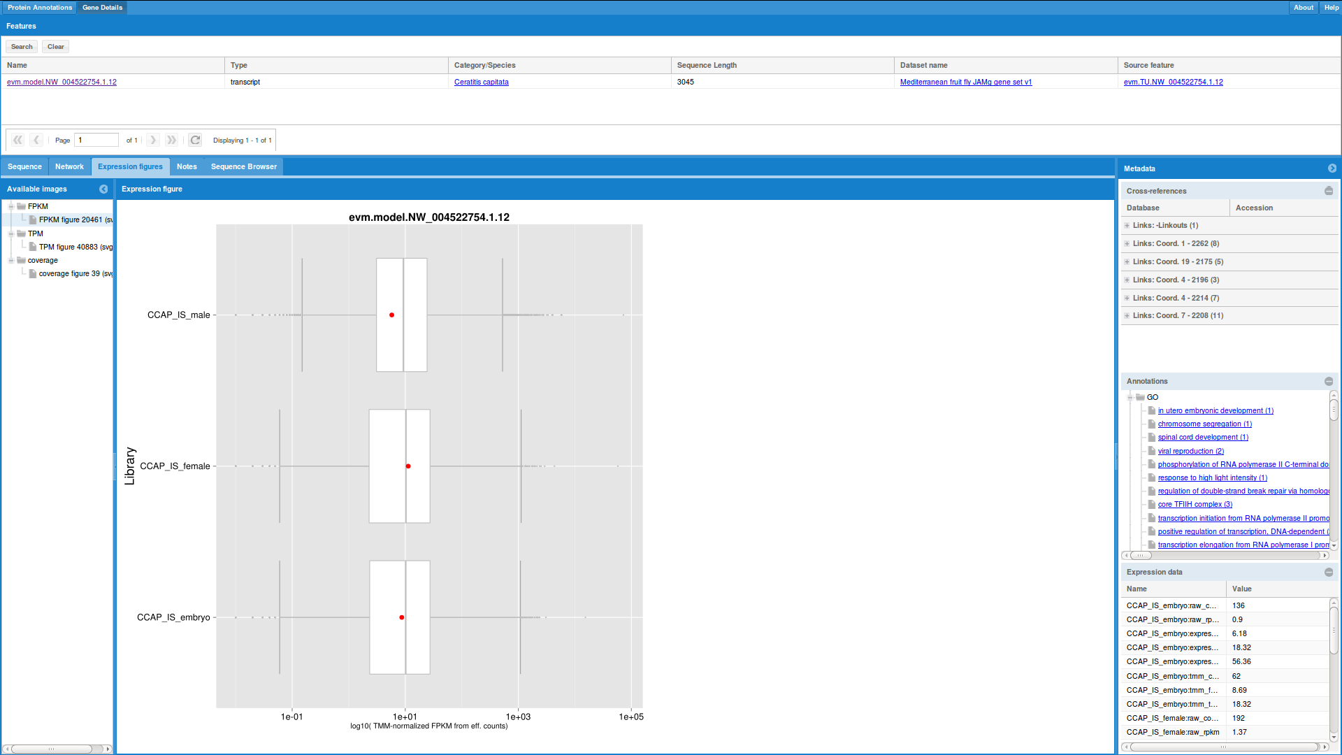
Expression
The FPKM, TPM graphs look like boxplots and a red dot. The boxplot are the distribution of all the genes for that library. The red is for that one library. In this example, this gene is expressed around the median value for every library.
Due to the normalizations, when you look at expression, the boxplots should be very similar.
The Expression data tab has the exact values for each library and expression measure.

Slide 84
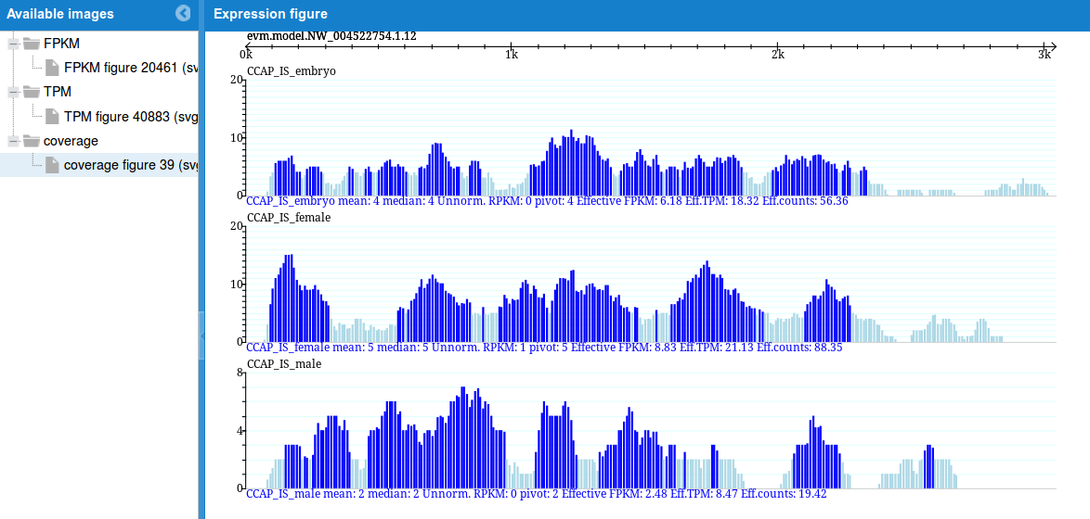
Expression
The coverage graph shows how the gene is covered by each RNA-Seq readset.
It is important it to check before believing any expression values (for example, if only the 3’ of the gene is covered).
Also it is very useful for understanding if we predicted the gene model correctly.
I’d especially welcome any feedback and suggestions for new features, however please understand that with the current funding situation in Australia it is unlikely we can do much soon.

Slide 85
Evidence: Load the tracks you find most useful. We have an explanation of what the tracks are and where the info has come from if you click on ‘About Track’.
There are many here that you can use however I have outlined the ones that I find most useful to help me annotate. I often drag up multiple tracks predictions / genes and then build one gene.
Login in Web Apollo and Select Scaffold by clicking on the ‘EDIT’ button next to the scaffold
Select Tracks
Gene Models – NCBI and JAMg
Alignments –if you provided gene families
Domains
Alignments – all transcriptome coverage
Alignments – transcriptome junction
Other: GAPs in assembly
Find putative genes and drag multiple lines of evidence up to the curation track
The transcriptome (assembled genes) and read (raw reads from transcriptome) junctions can help with deciding if domains belong to one transcript/gene.
Check start and stop codon, intron and exon boundaries
Align with gene family. When window pops up you can click on Start Jalview to see coloured alignment. Can build trees from there (Calculate → calculate tree → chose tree). Can then sort alignment by tree (Calculate → sort → by tree order).
You can also use the BLAST or SIGNALP webservices
Validate your gene model look as expected using known genes or a bioinformatic approach

Slide 86
Check with alignment if the gene is correct
Select whole gene (click on intron). Right click to bring up the context menu
Select Align with and either select one
of the precomputed profiles (if provided) or
‘with user sequences’ and provide either an existing alignment or unaligned raw sequences.
This will (profile) align the gene model against the sequences.
Align with gene family. When window pops up you can click on Start Jalview to see coloured alignment. Can build trees like so:
Calculate → calculate tree → chose tree (identity is good).
Then sort alignment by tree (Calculate → sort → by tree order).
View the alignment with JalView and use a tree to check if it is ok.
Add comments and update status
When happy, finalize the curation
NB: there is no reason you have to follow this workflow. If you already have a preferred workflow that works (e.g. Geneious), use that. We’re just trying to provide tools that work for everyone and are primarily web-based (i.e. shareable).

Slide 87

Thank you now let’s go make the best annotated insect genome!
Alexie Papanicolaou
Email: pap056@csiro.au
CSIRO Land & Water Flagship CSIRO Biosecurity Flagship Research in land, water, ecosystems, cities, social & economic sciences, pollution, earth observation & climate adaptation
Monica Poelchau
Email: Monica.Poelchau@ars.usda.gov
United States Department of Agriculture National Agricultural Library
Monica Munoz-Torres
Email: mcmunozt@lbl.gov
Lawrence Berkeley National Laboratory
Berkeley Bioinformatics Open-Source Projects
Genome Curation Guide by Alexie Papanicolaou, Monica Poelchau, and Monica Munoz-Torres is licensed under a Creative Commons Attribution-NoDerivatives 4.0 International License.
http://tiny.cc/curation_train (public release due Oct 2014)

